Slide 1

Capstone Project Report
On
“TRAVEL APPROVAL APP”
BY:
Name: Purnachandar Atike
Batch WIP-SF-13
LMS Id: MGSA_515

Slide 2

CONTENTS
• INTRODUCTION TO SALESFORCE
• INTRODUCTION OF TRAVEL APPROVAL APP
• MODULE 1
• MODULE 2
• MODULE 3
• CONCLUSION

Slide 3

INTRODUCTION TO SALESF
• What is salesforce?
Salesforce is a cloud-based software company that provides businesses with tools that
prospects, close more deals, and provide a higher level of service to their customers.
Salesforce helps businesses keep track of customer interactions and sales data. It can manage leads, contacts,
opportunities, and cases. Salesforce also offers several features to help businesses automate their sales and
marketing processes, such as email marketing, lead capture, and lead scoring.

Slide 4

INTRODUCTION OF TRAVEL APPROVAL APP
• The travel approval project in Salesforce is a system designed
app to automate and streamline the process of requesting and
approving travel expenses for employees. The project involves
several components, including a custom object to track travel
requests, a custom approval process, and various integrations
with external systems.
•
Overall, the travel approval project in Salesforce provides a
streamlined and efficient way for employees to request and
manage travel expenses, while also providing managers with the
tools they need to ensure that all expenses are approved and
accounted for.

Slide 5

MODULE 1
• This project module focuses on the non-coding approach to modifying
the user interface, as you customize an app that tracks company travel.
• Create Custom
App, Objects, Fields & Relationships, and how you customize the
App using
declarative tools.

Slide 6
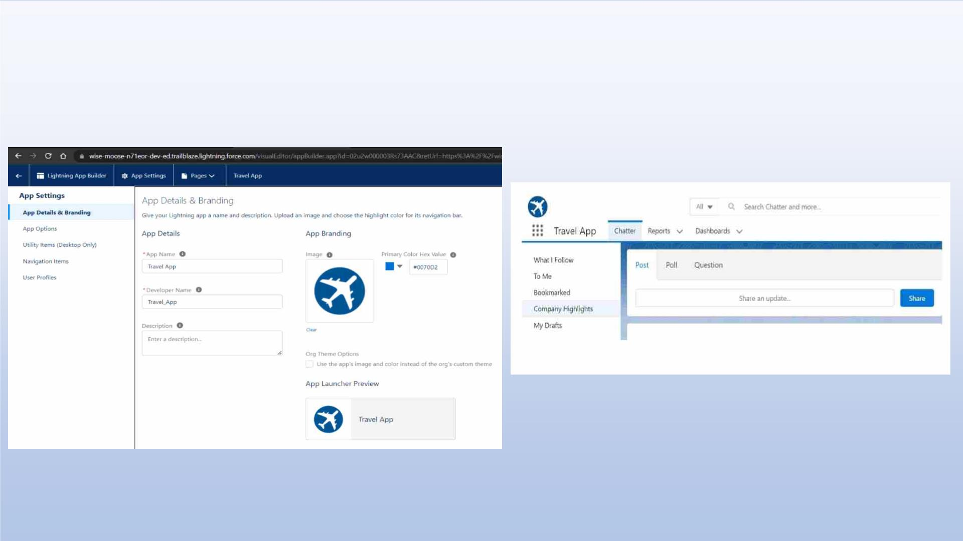
Creating Lightning App: TRAVEL APP

Slide 7
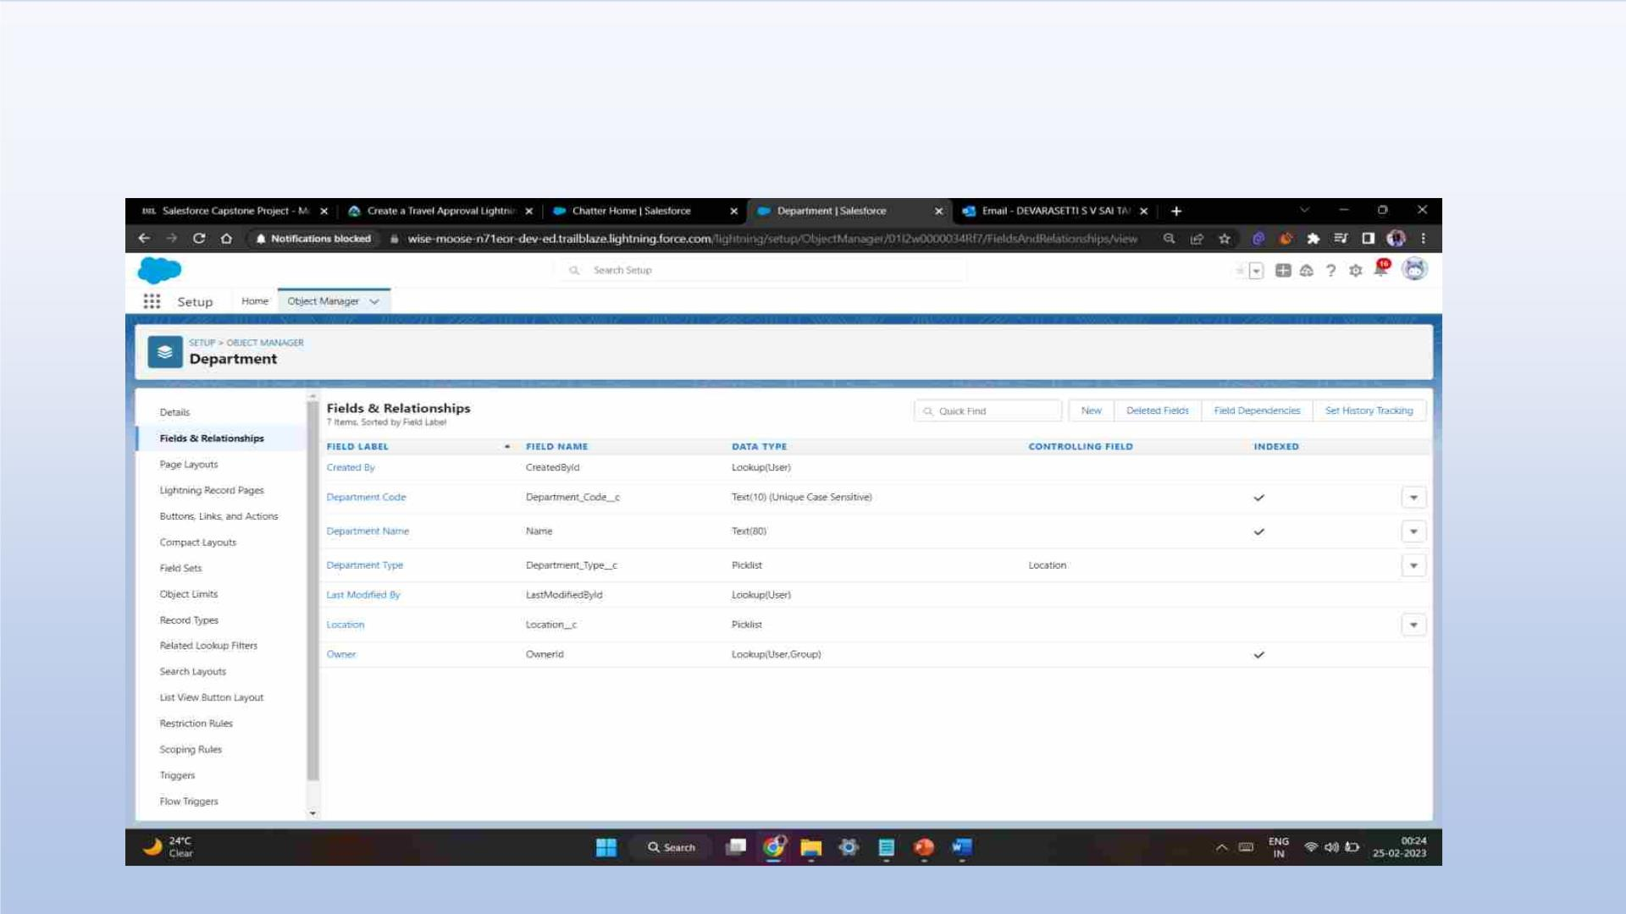
Custom object Department and Creating custom fields in Department object

Slide 8
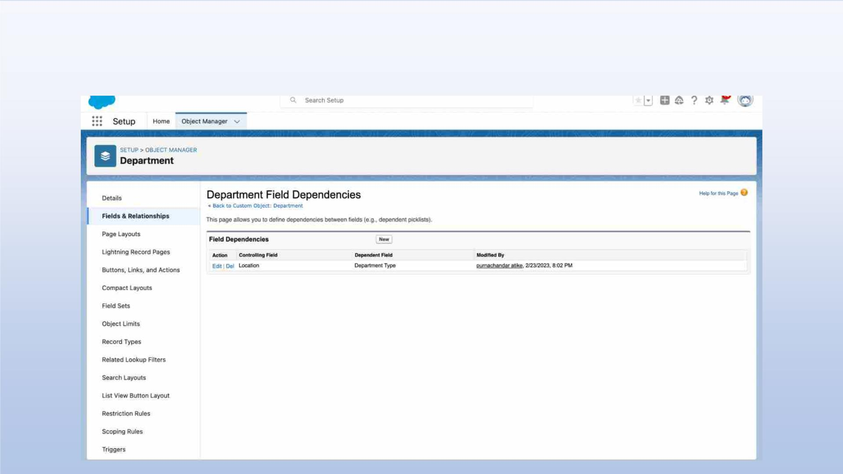
Field dependency in department

Slide 9
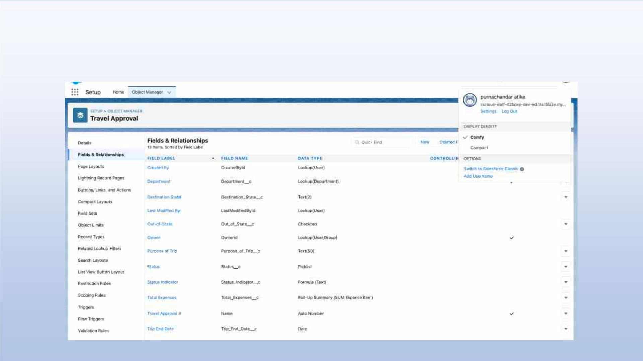
Creating Custom Object Travel Approval and Custom Fields in that Object

Slide 10
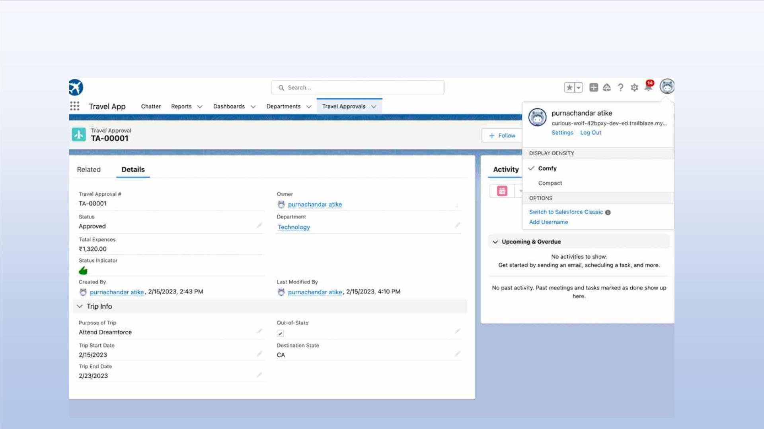
After creating travel approval object with fields, it looks as shown
below

Slide 11
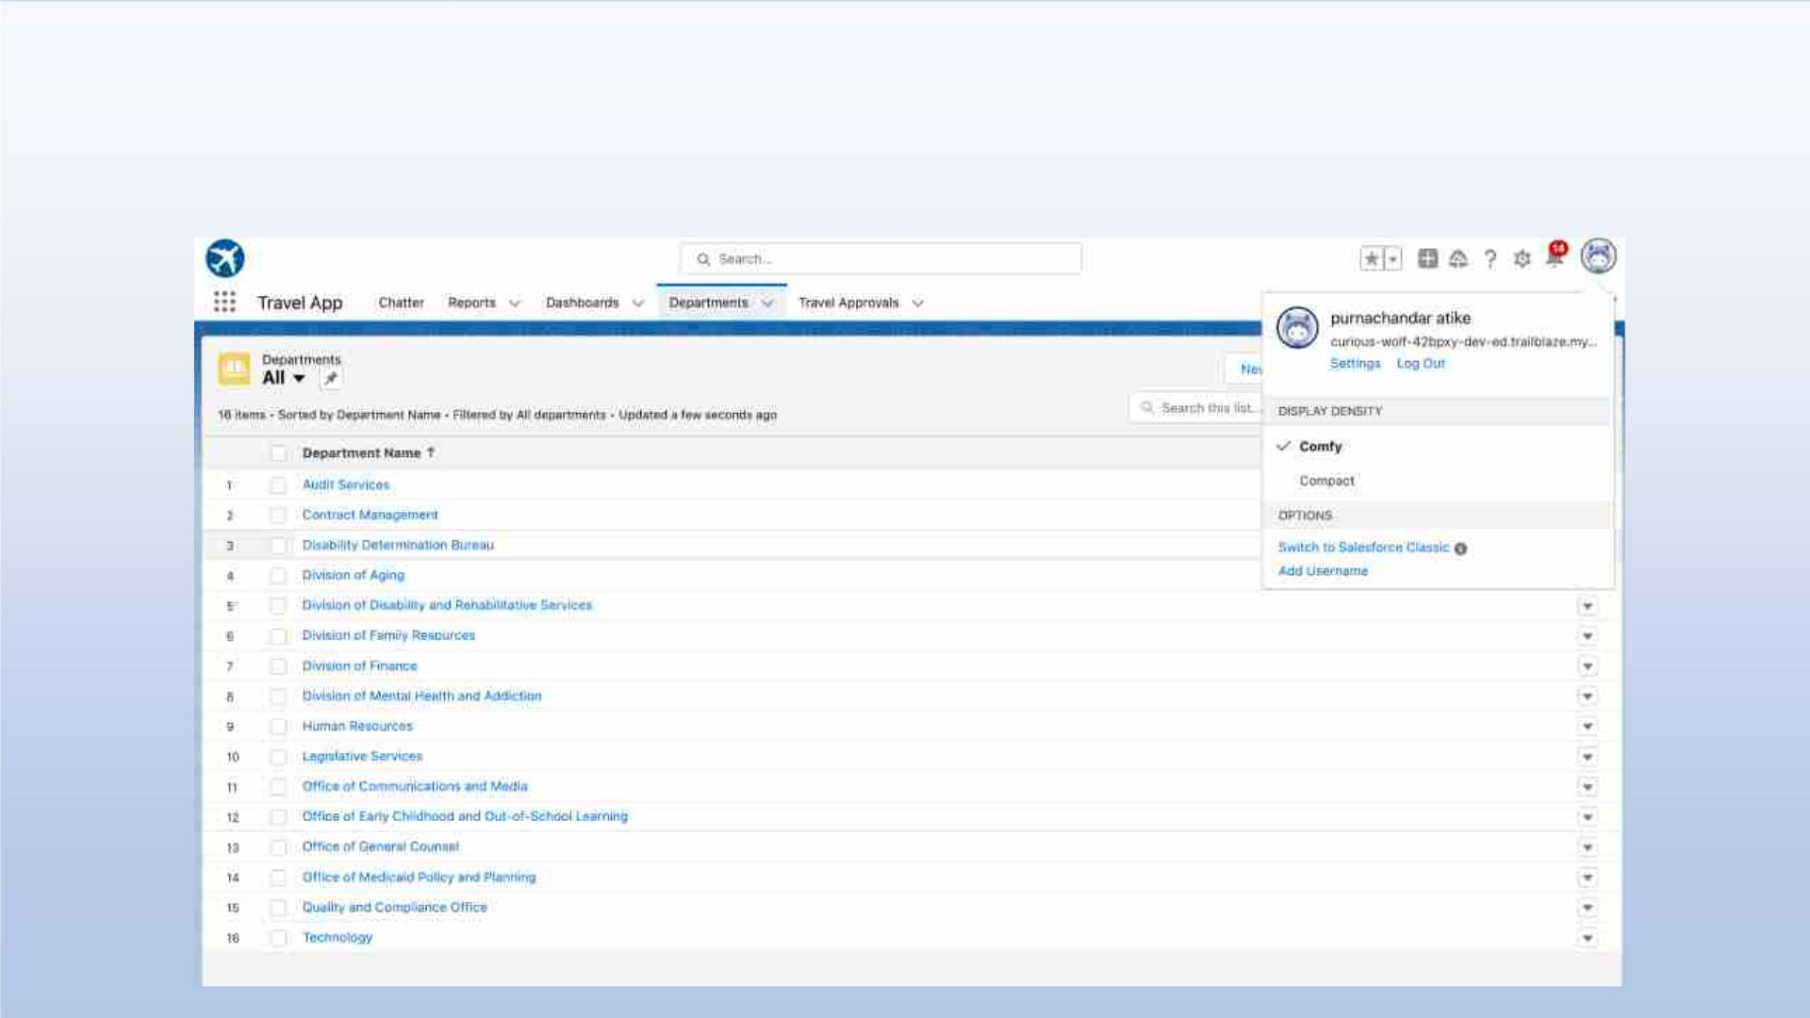
Importing Department records using data import wizard and
imported record data status can viewed below

Slide 12
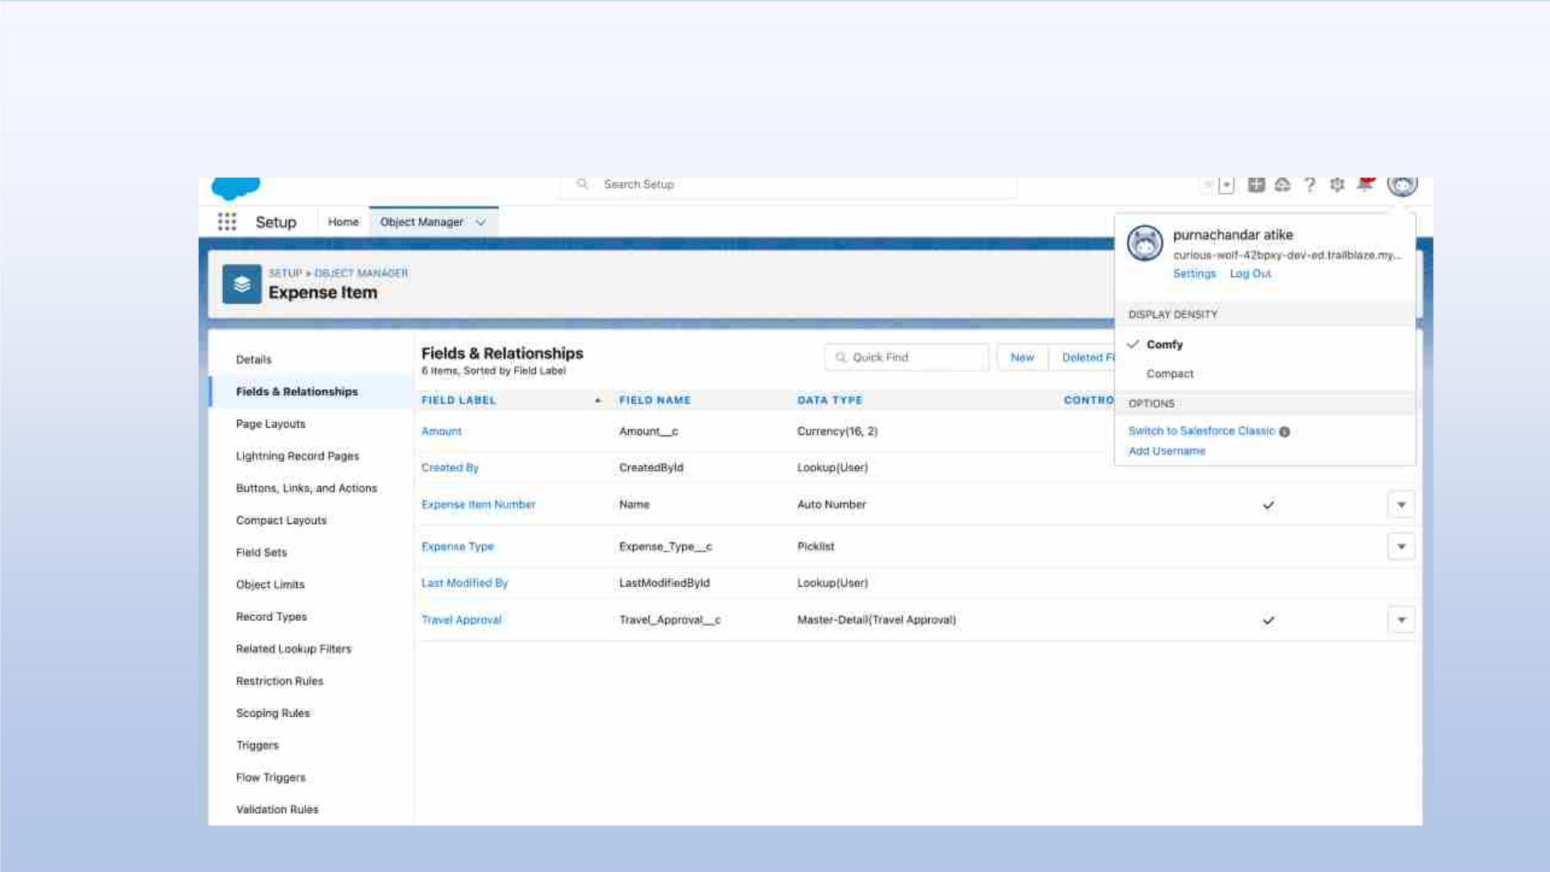
Creating Expense Item custom object and Custom fields in Expense Item
object

Slide 13
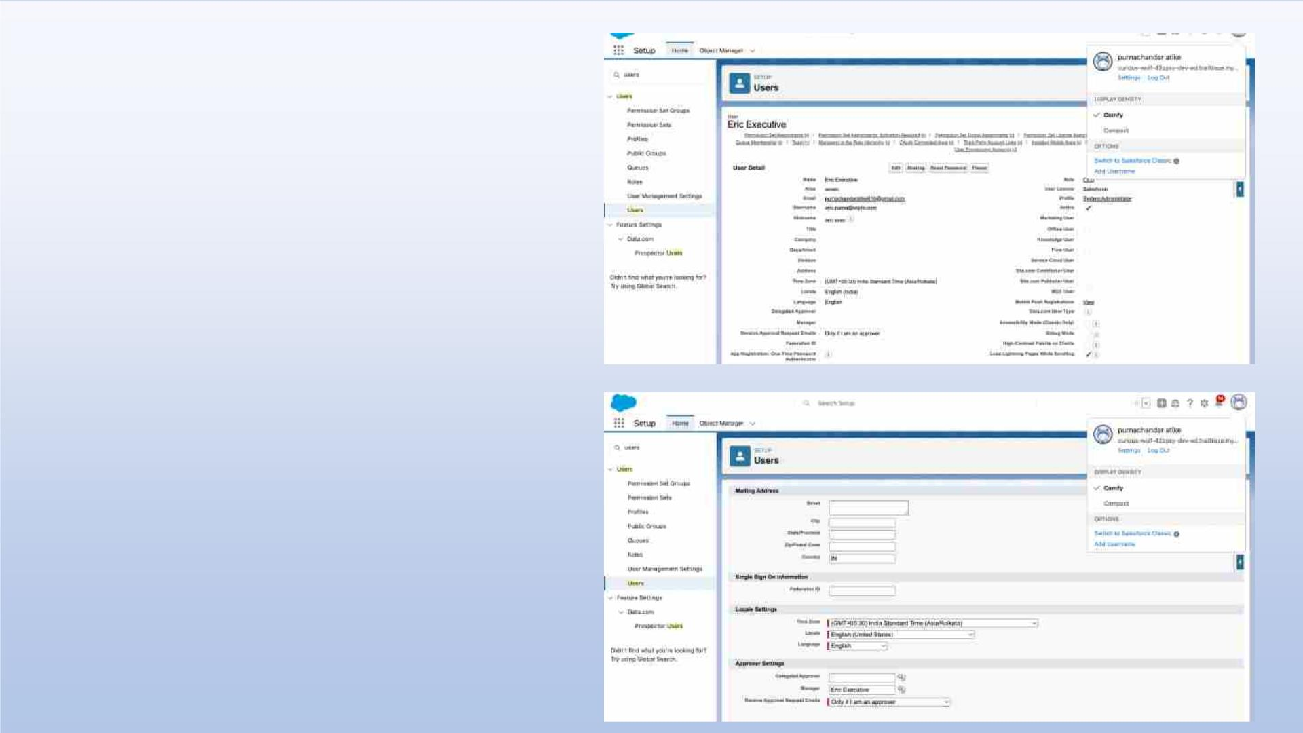
Creating User with
system admin license
Add user eric as
manager own account user

Slide 14
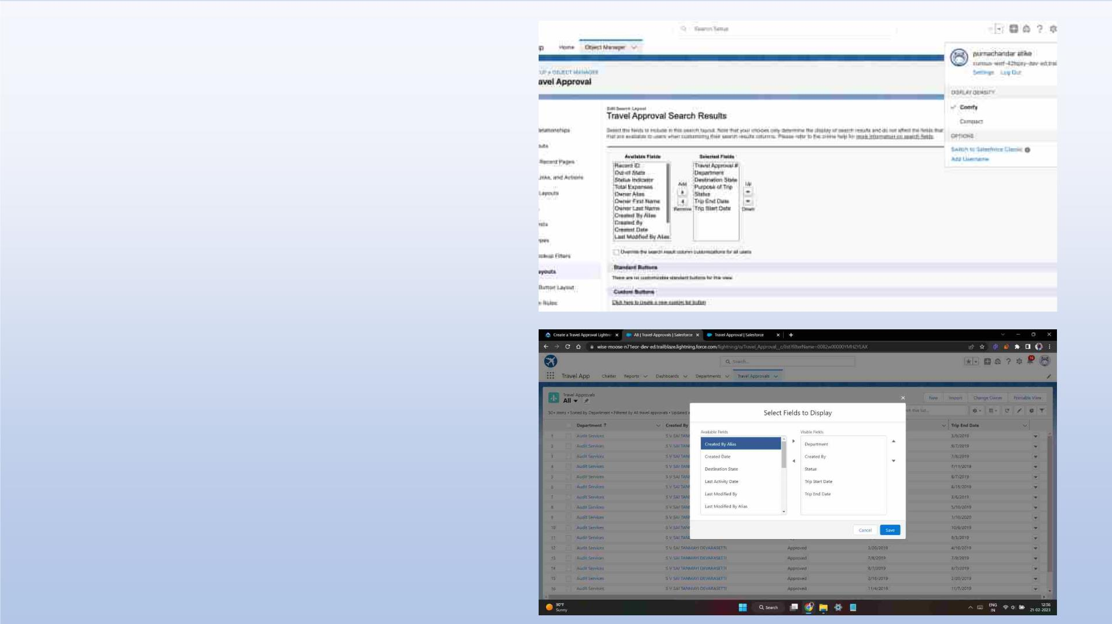
Customize the Travel Approval
Default search layout
Select fields to display in the Travel
Approval “All” List view

Slide 15
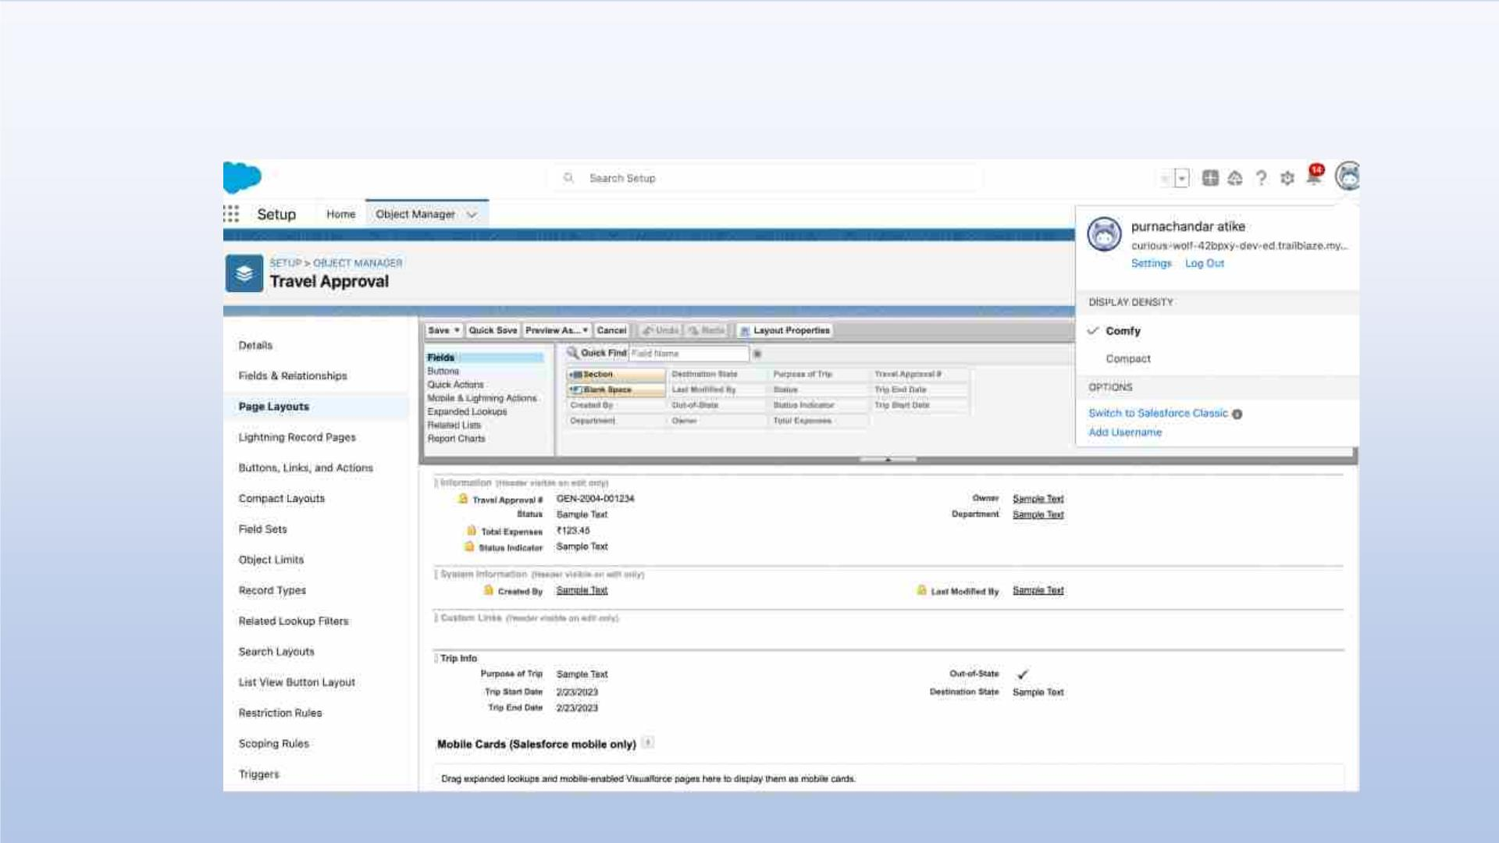
Customizing page layout

Slide 16
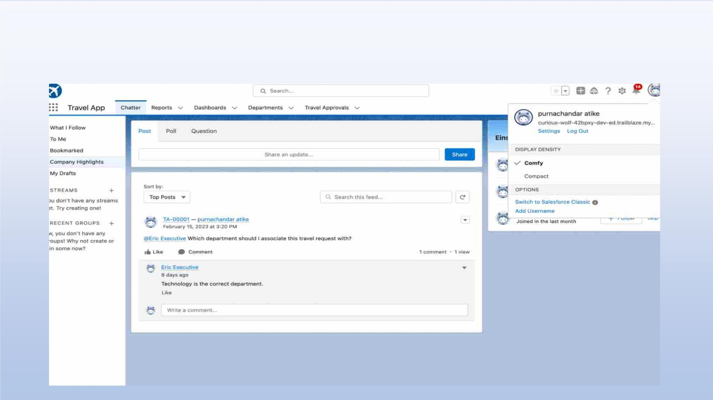
Test the app:

Slide 17

MODULE 2
• This project module focuses on the Automation and Analytics Tools
to enhance your custom App development.
• Define Business logic using Validation rules, Roll-up summary fields,
Formulas, Flows & how you track Travel Approvals using Reports and
Dashboards

Slide 18
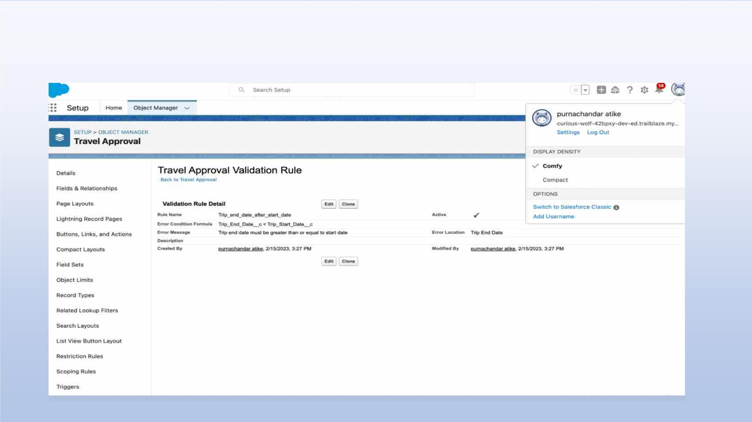
Validation Rule that trip end date always >= start date

Slide 19
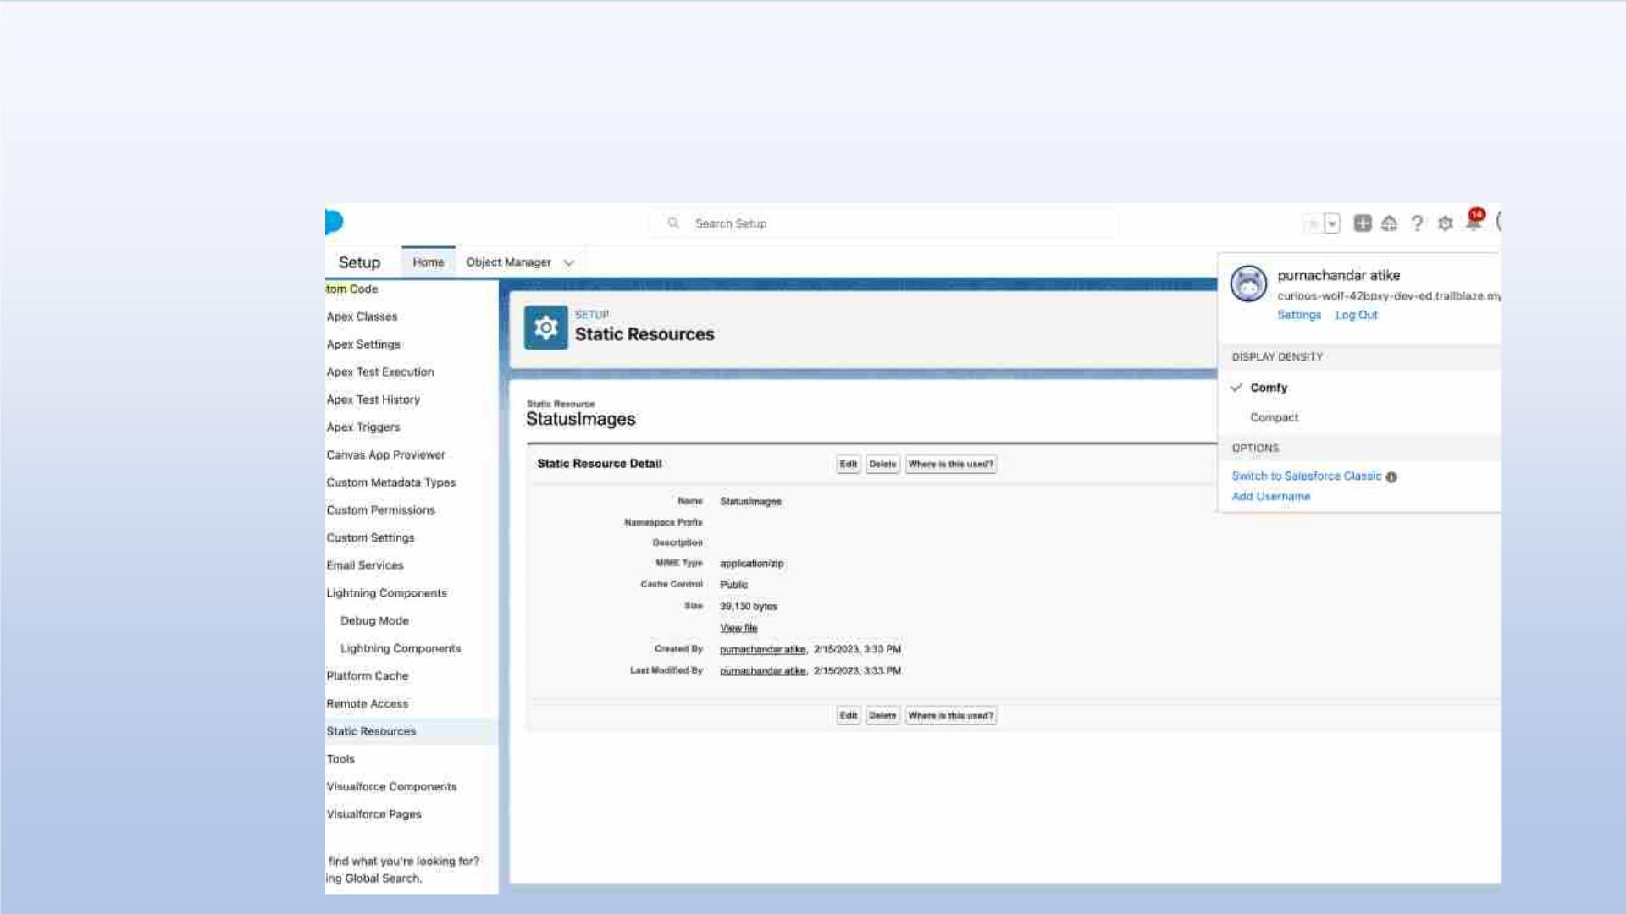
Creating Formula Fields
Static Resource with name StatusImages

Slide 20
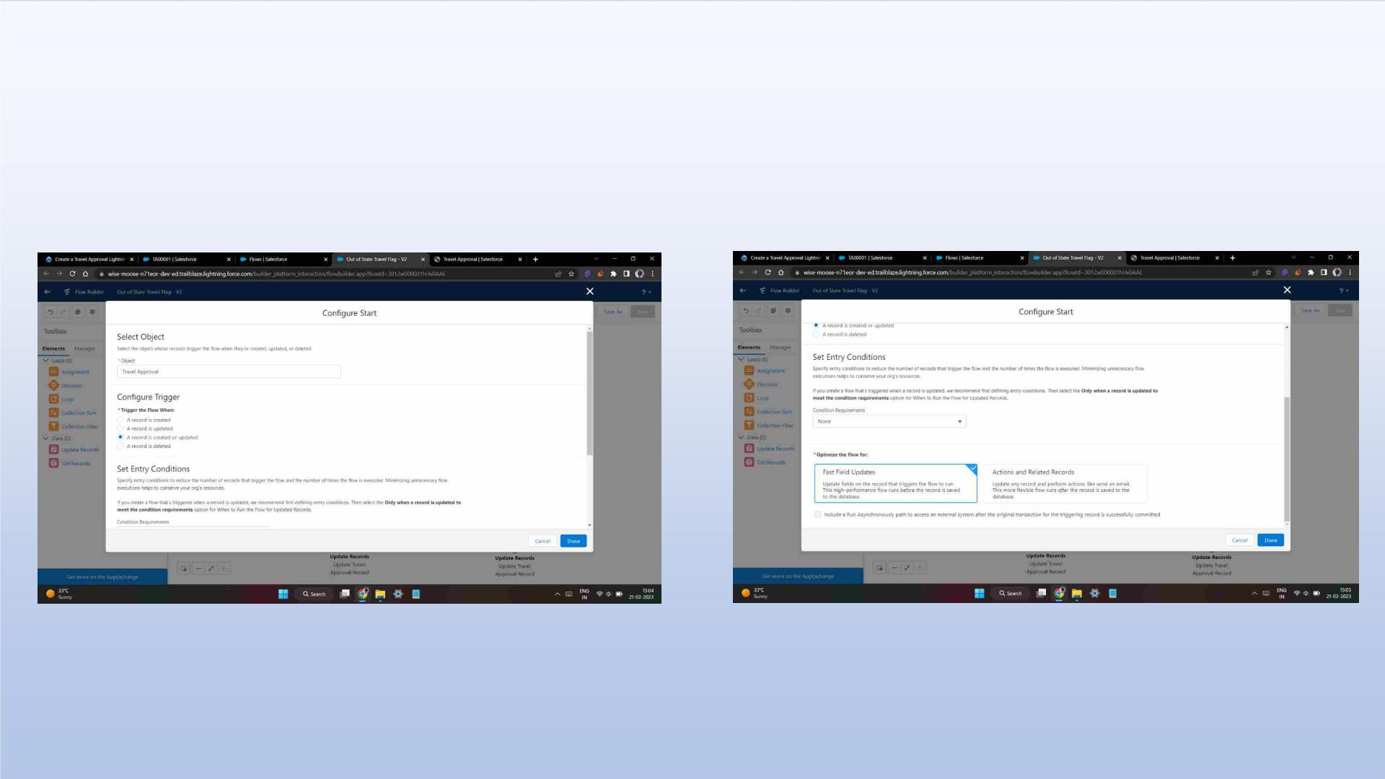
Create a Record – Triggered Flow

Slide 21
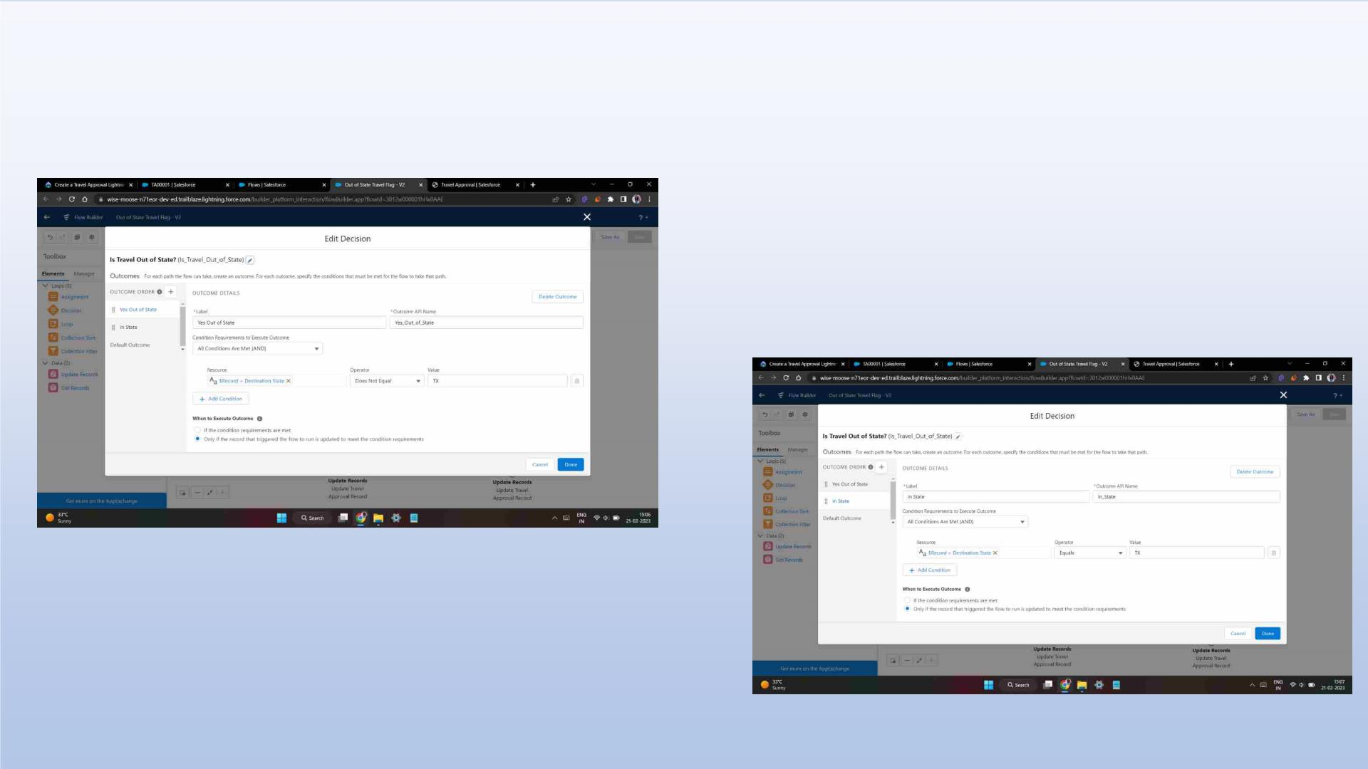
And add Decision element to flow

Slide 22
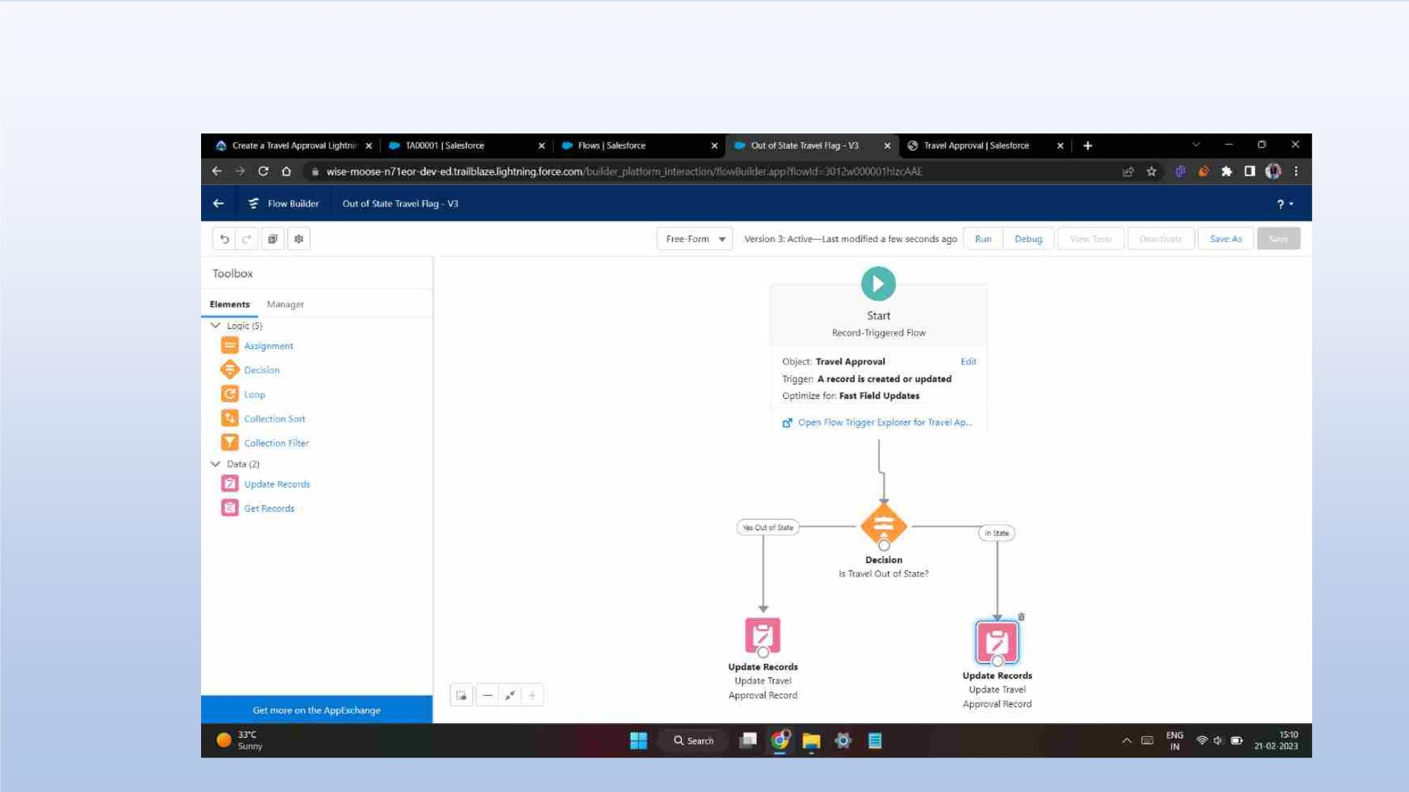
Finally, the flow looks as shown, save and activate

Slide 23
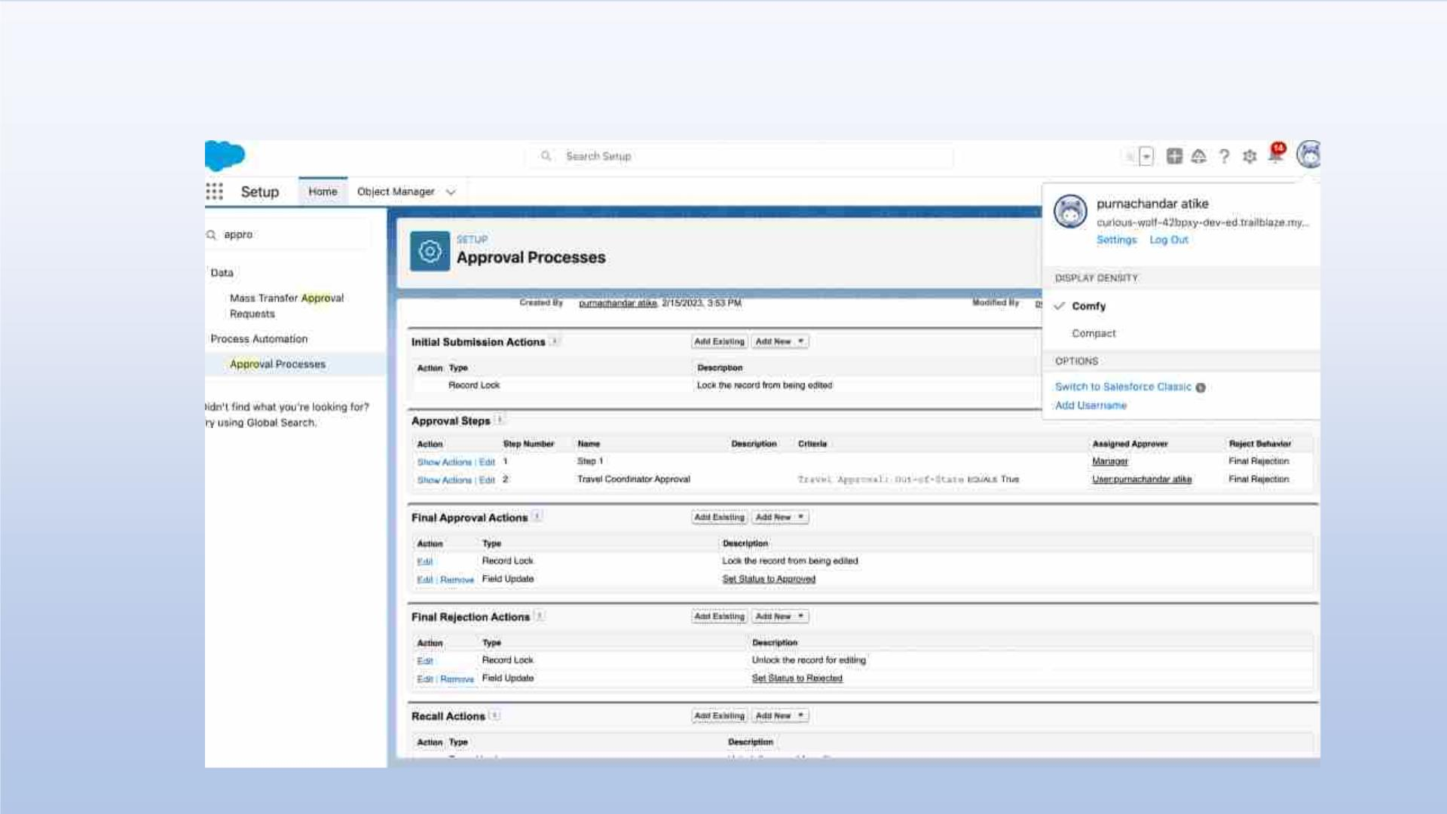
Creating an Approval Process to send travel approvals to manager or travel
coordinator

Slide 24
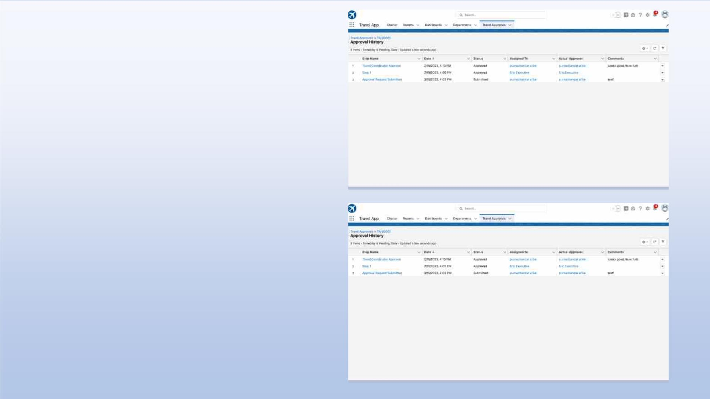
Testing the approval process Status is
pending here, Next submit for
approval
Login as Eric to give Approval
Can Approve or Reject

Slide 25
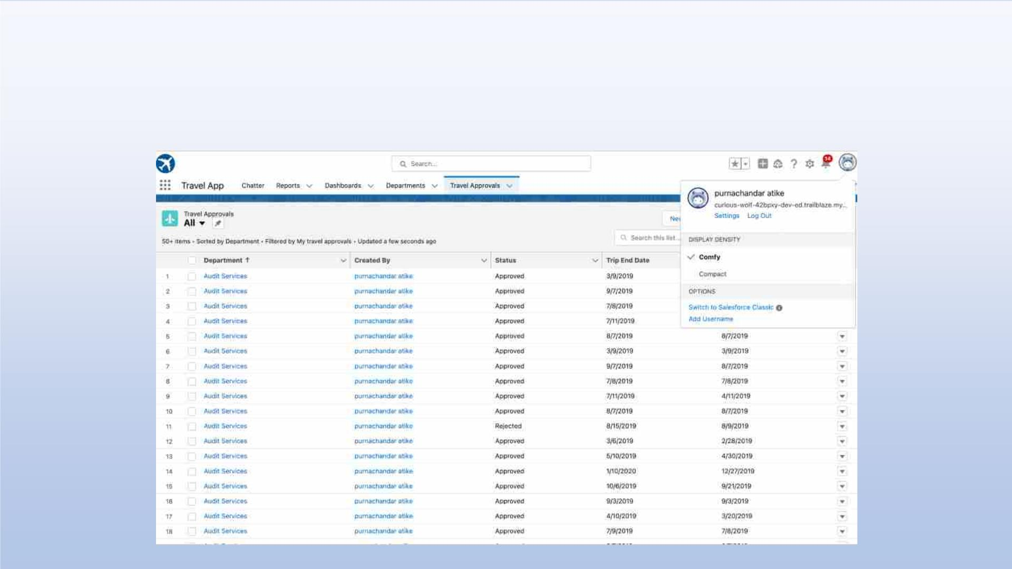
Using Data import wizard to import travel approval records , later the Records
imported successfully

Slide 26
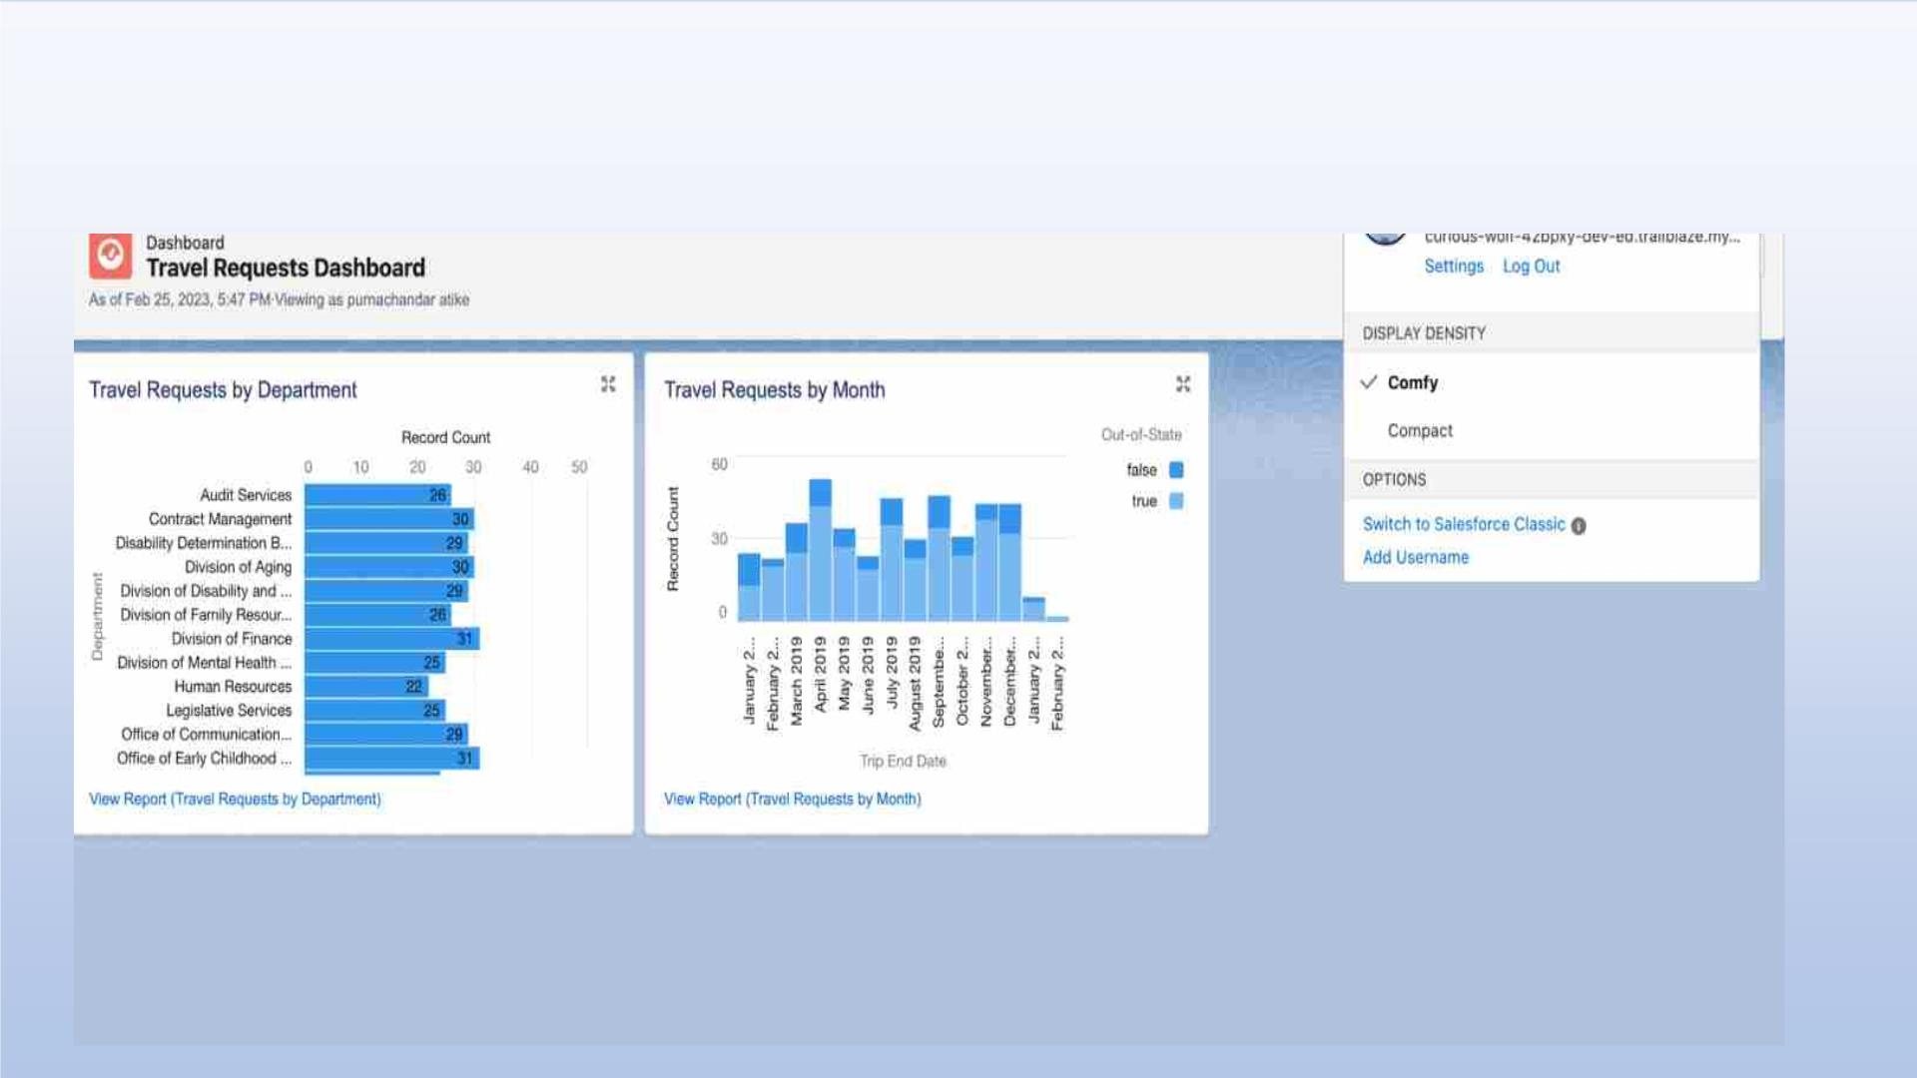
Final Dashboard

Slide 27

MODULE 3
•
This project module focuses on the coding approach to extend the
functional capabilities of your custom App.

Slide 28
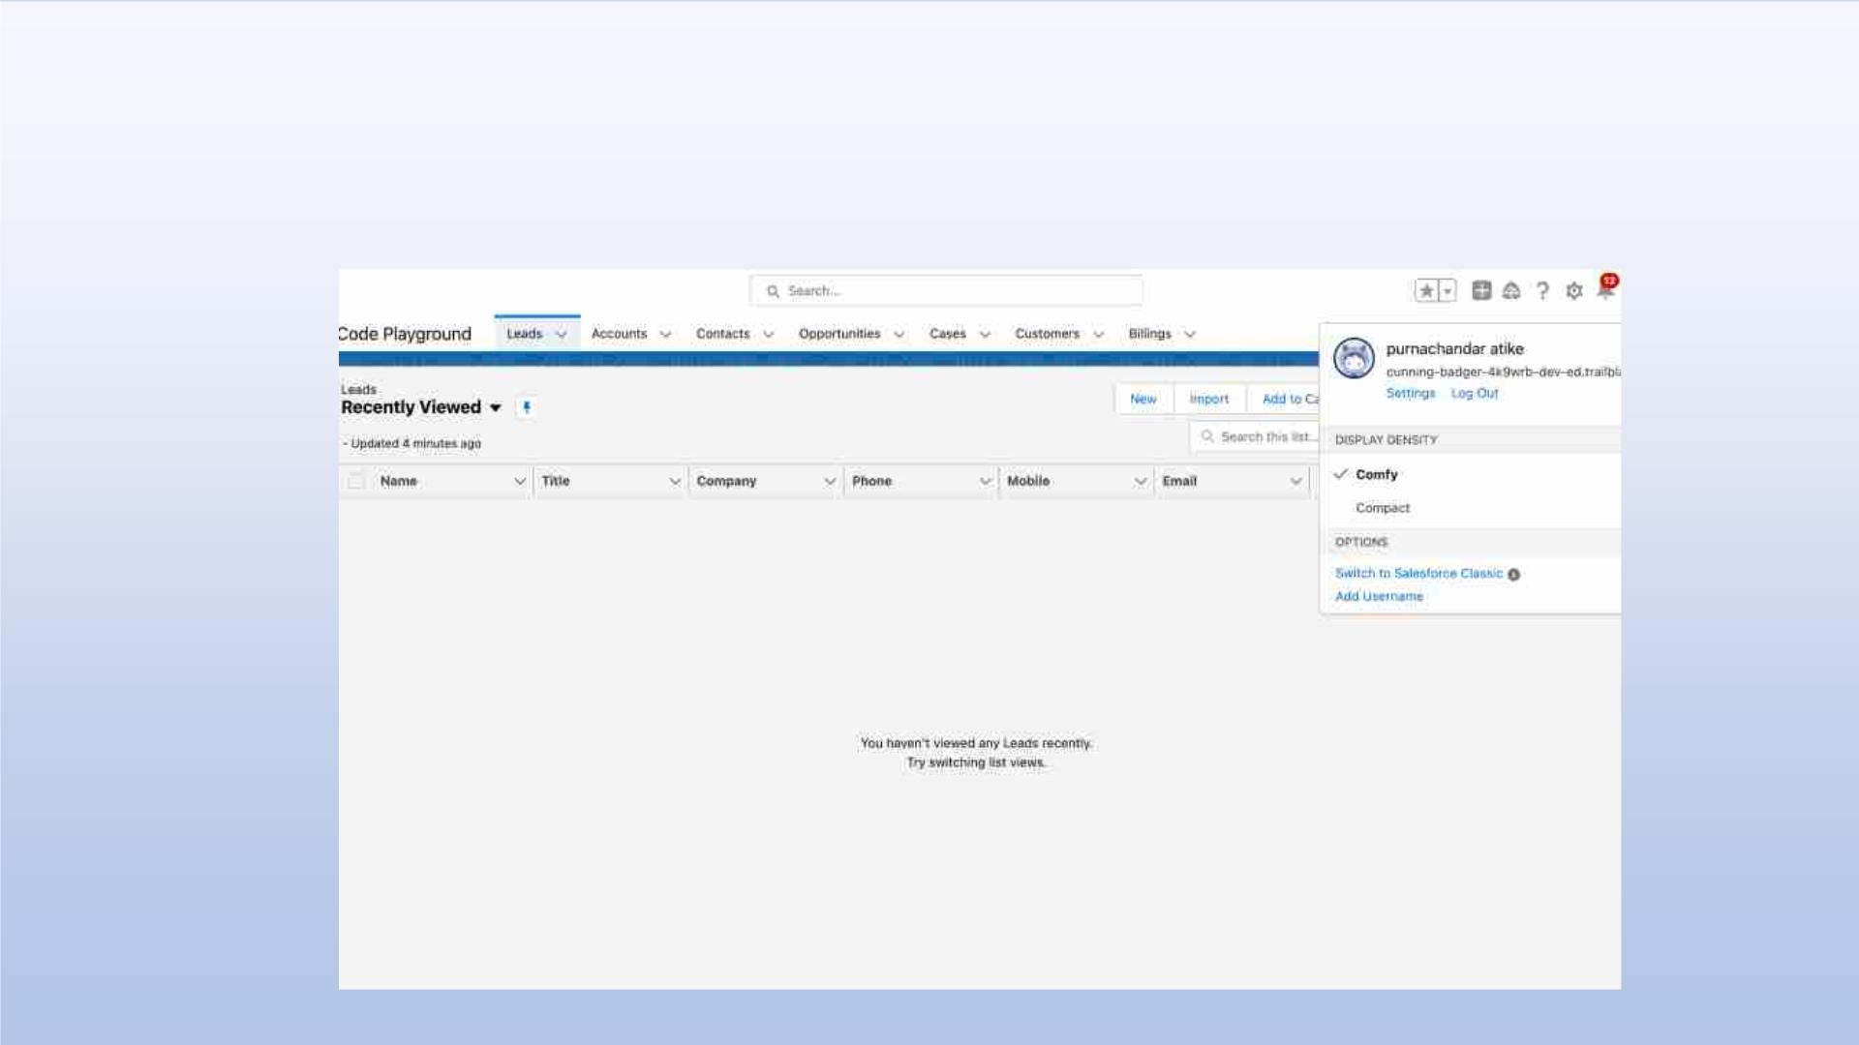
Exercise - 01
Creating Code Playground Lightning App with Lead, Account, Contact, Opportunity,
Case to navigation profile as system admin.

Slide 29
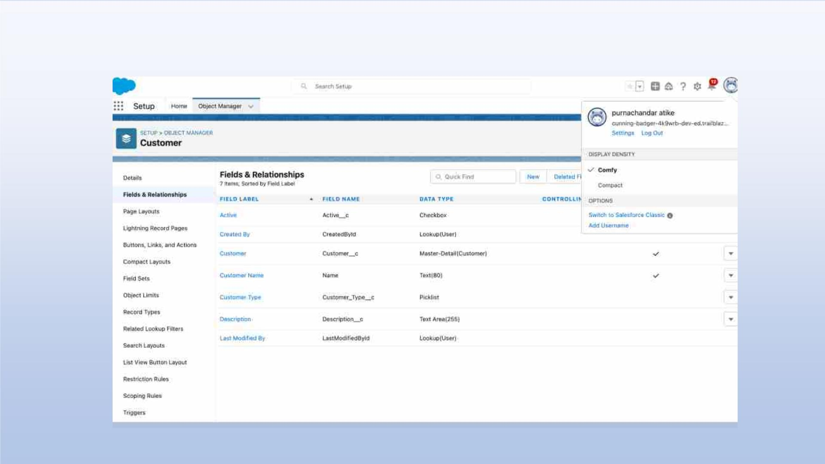
Creating custom object Customer and add related fields

Slide 30
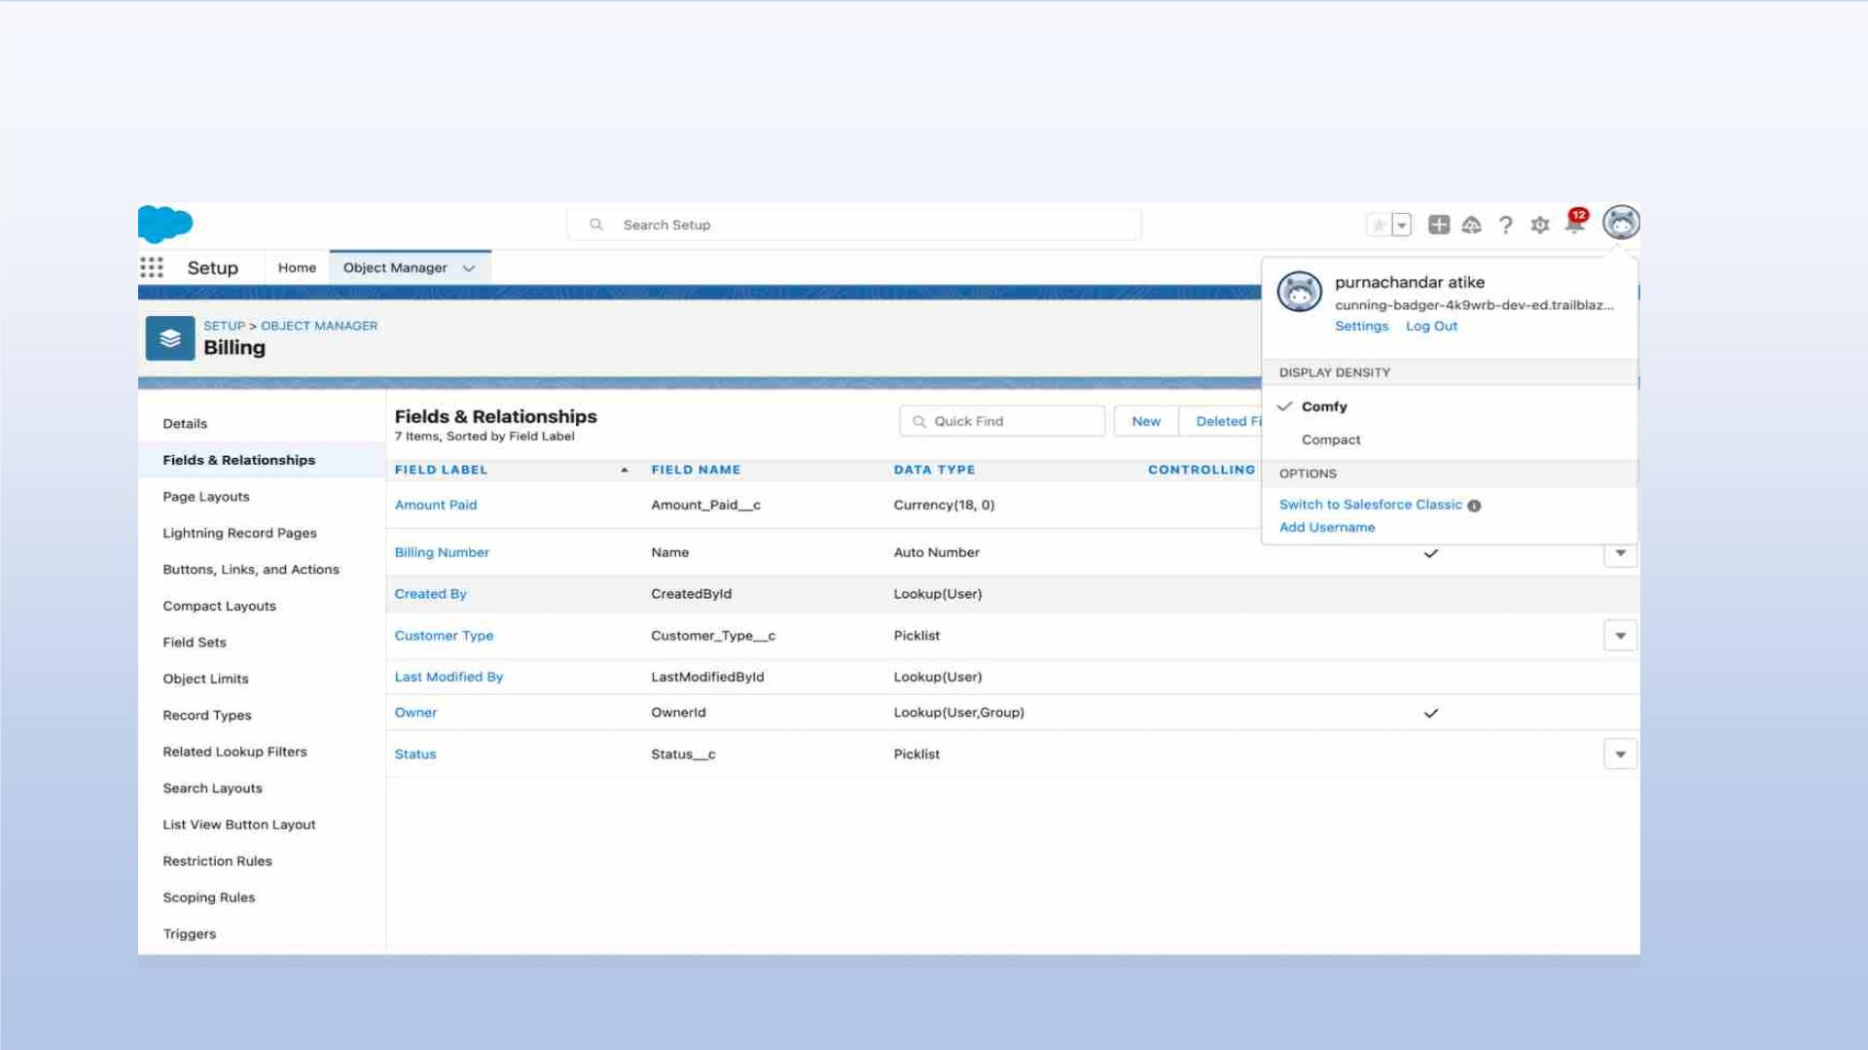
Creating custom object Billing and add related fields

Slide 31
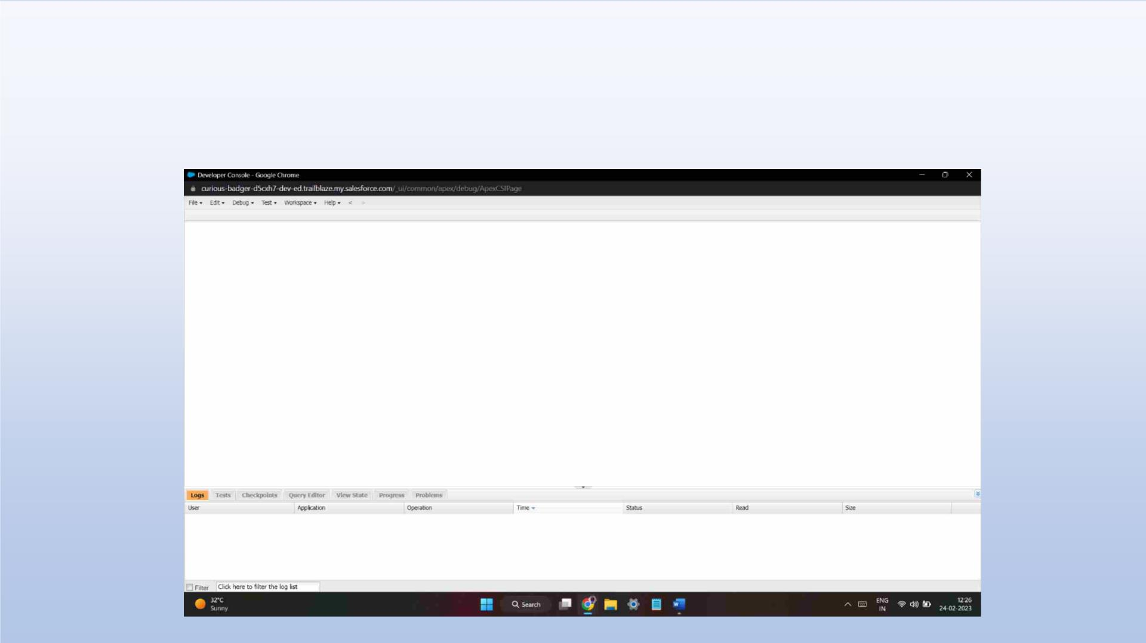
Exercise - 02
Use Execute Anonymous to define and execute the following code:
Developer Console

Slide 32
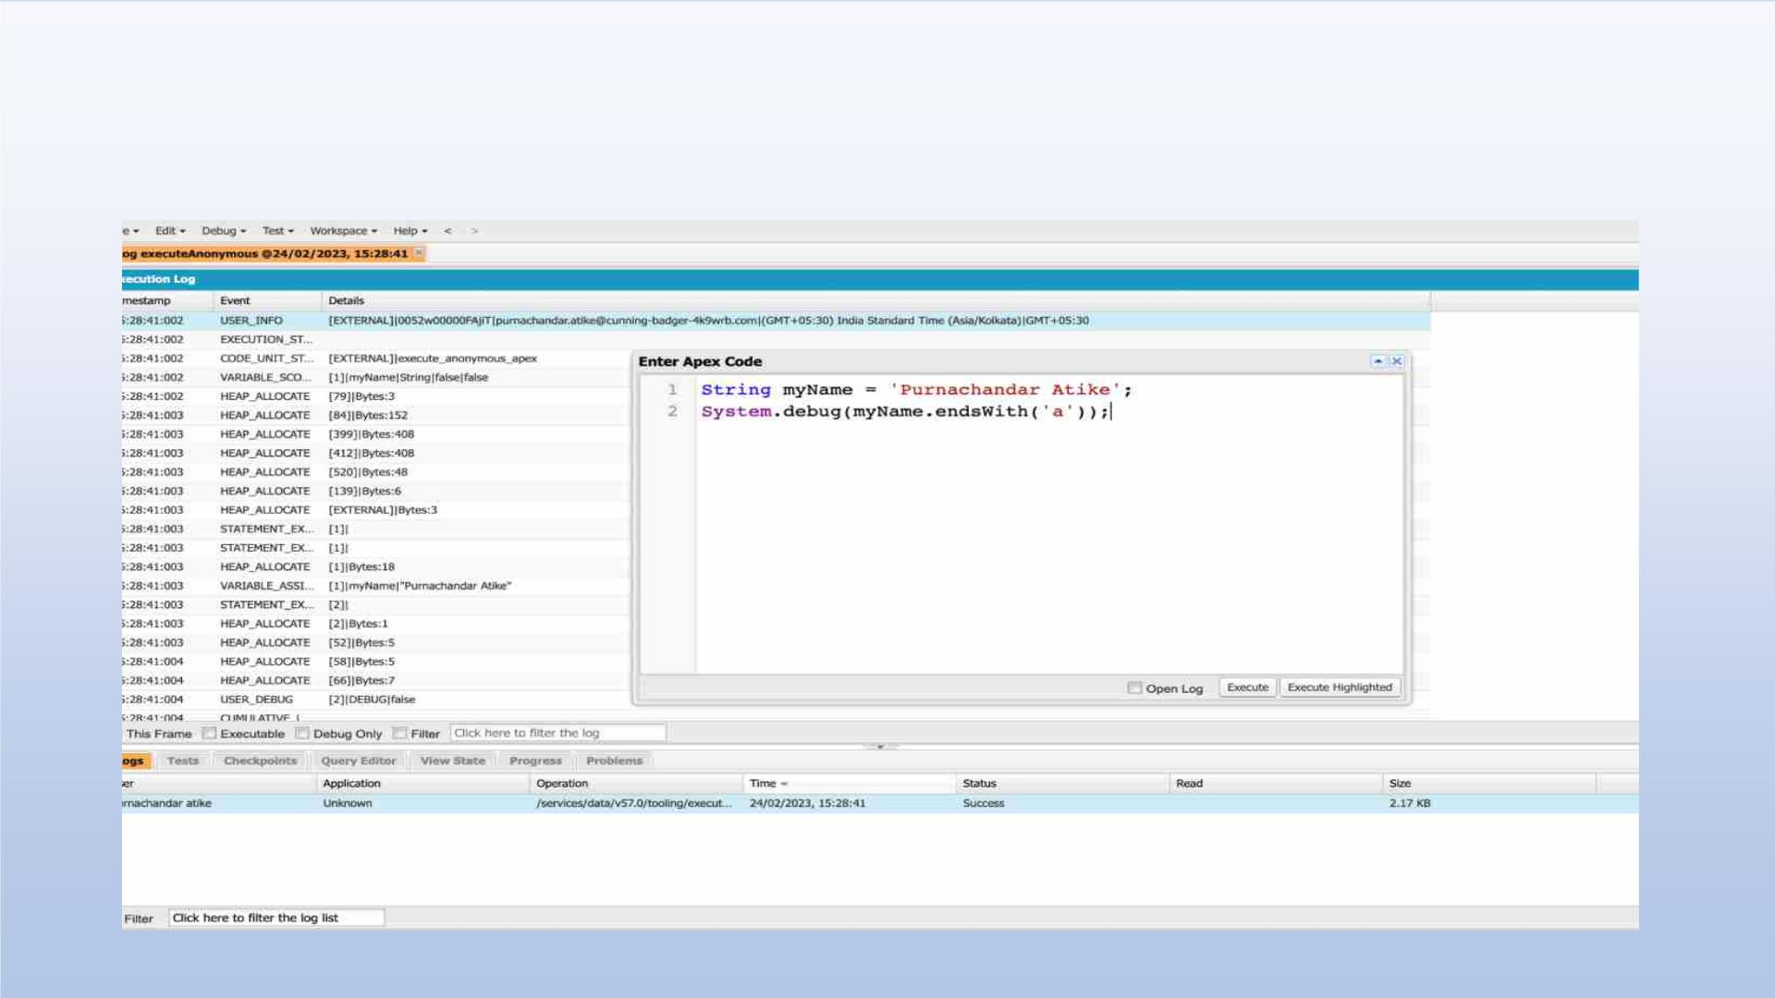
1.Define a String Variable & use string method ‘endsWith’ to display the
output. By clicking oh Debug and select open Anonymous window

Slide 33
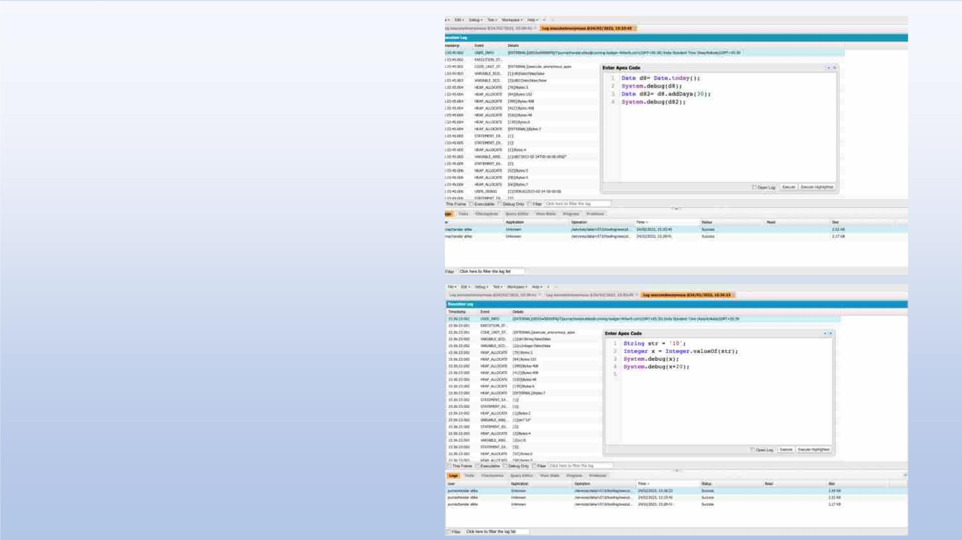
2. Define 2 Date type variables, use
Date method today() & addDays(30)
to display the output
3. Display the output of an Integer
variable from string ‘10’ and then add
20 to it.

Slide 34
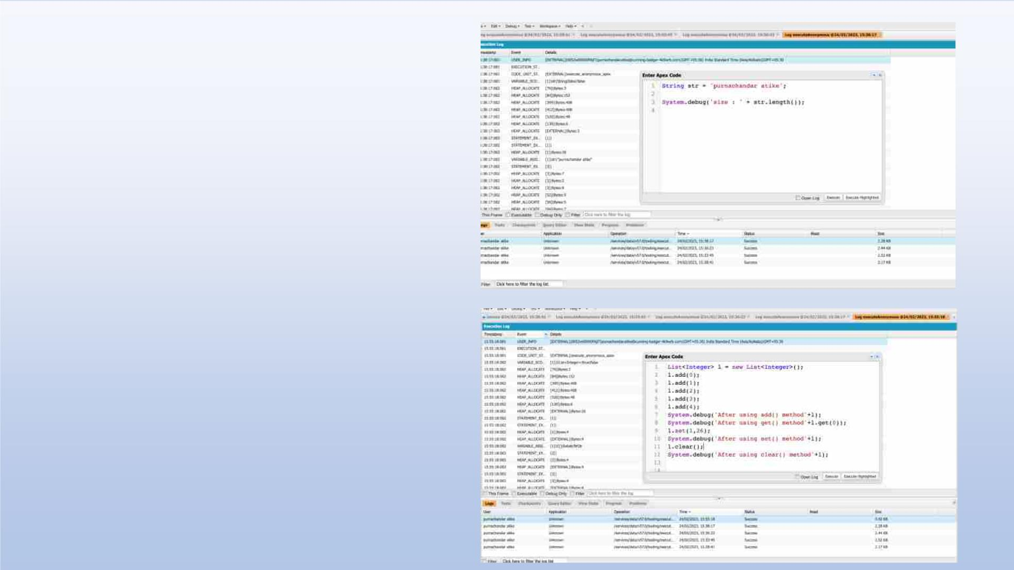
4. Define a String Variable & use
string method length() to display the
output
5. Define a List of integer and display
the output using add(), get(), set(),
clear(), methods.

Slide 35
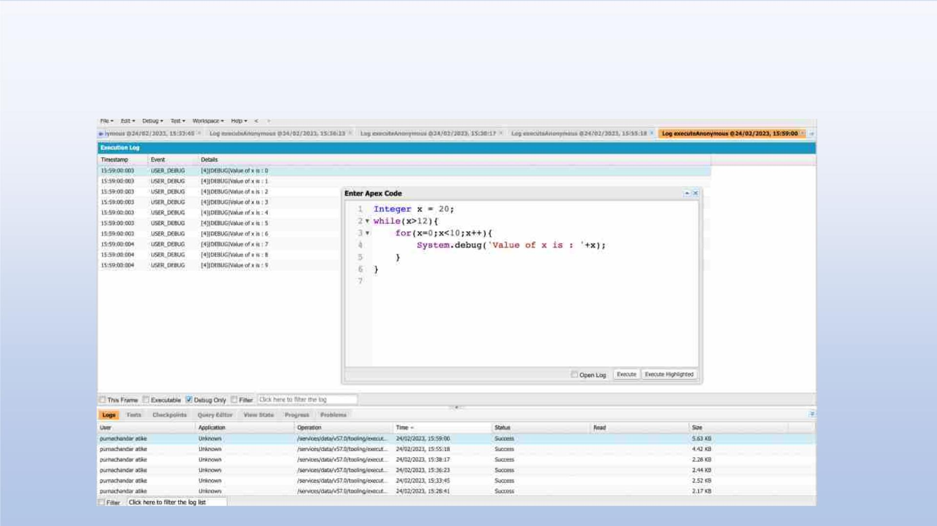
Use Execute Anonymous to define and execute the following code to display the
value of x = 0 to 9.

Slide 36
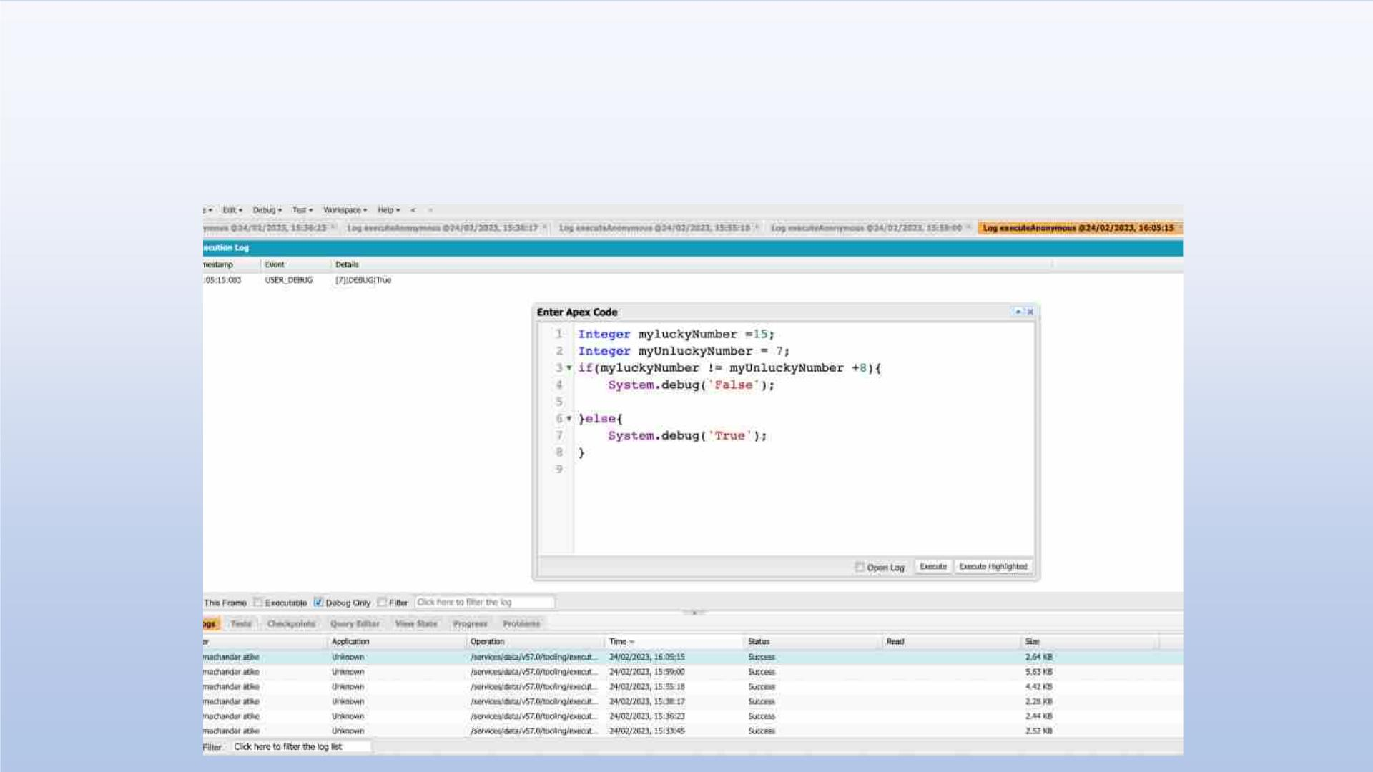
Exercise 3
Answer the following in True or False:
Integer myunlucklyNumber = 7; Integer myluckyNumber = 15;
myluckyNumber != myunlucklyNumber + 8.

Slide 37
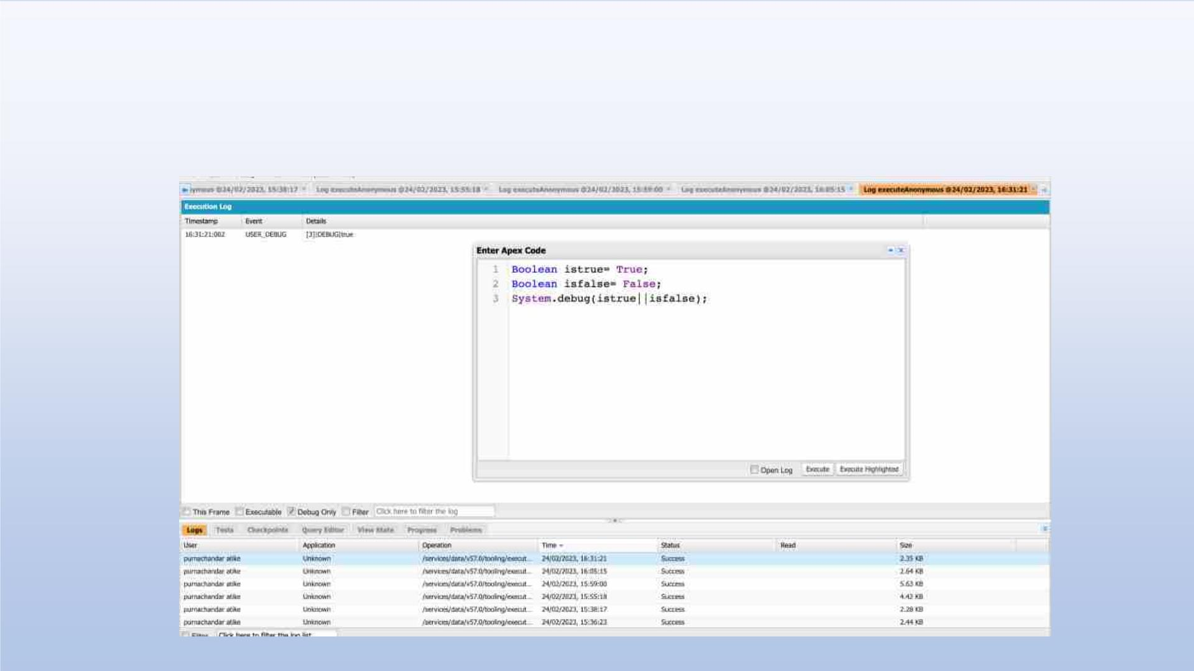
Exercise 4
Answer the following in True Or False:
Boolean isFalse = false; Boolean isTrue = true;

Slide 38
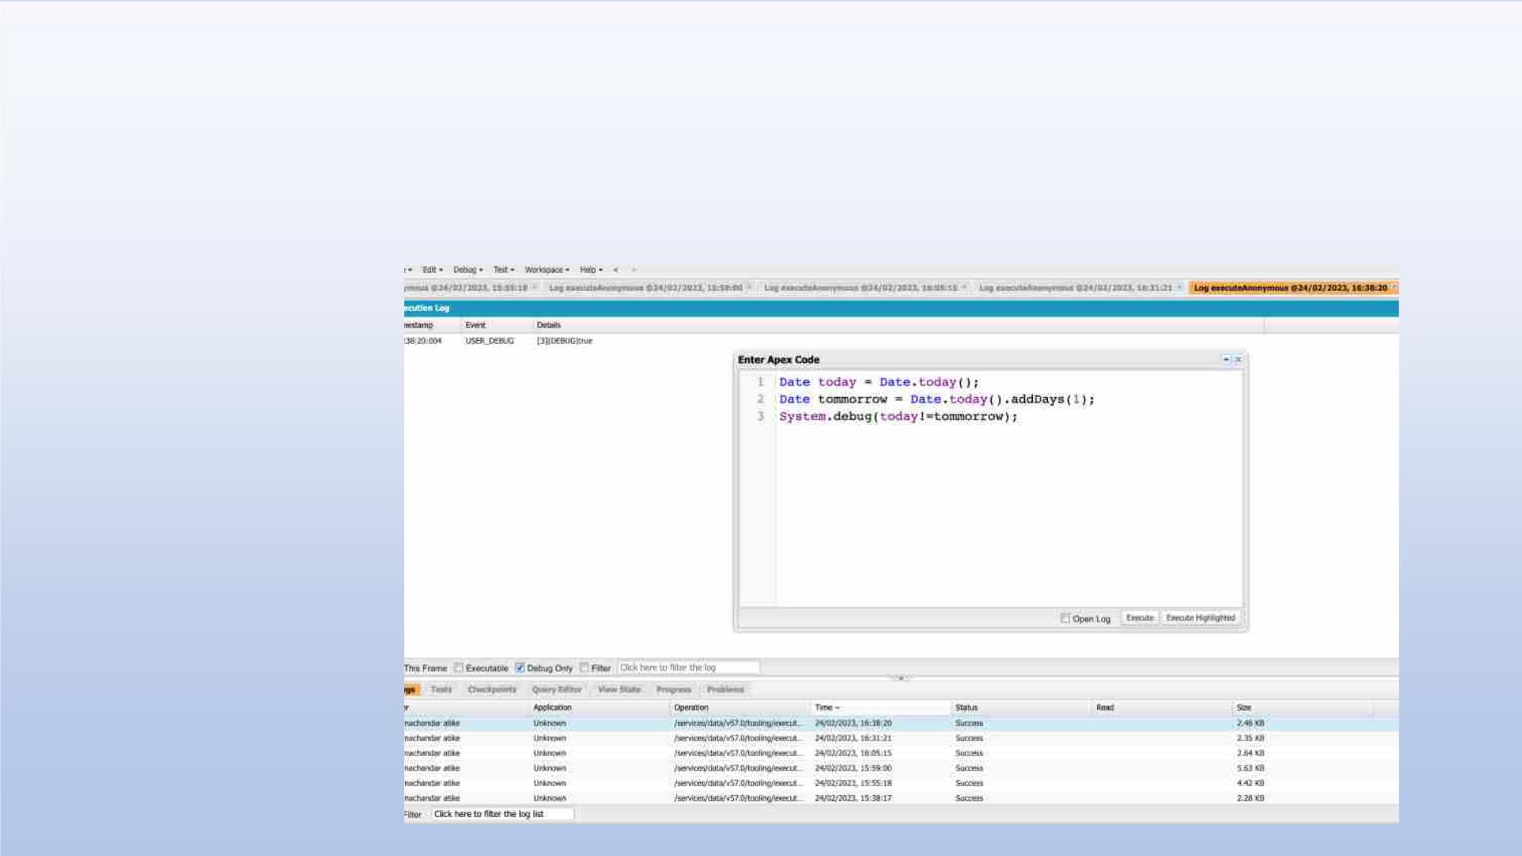
Exercise 5
Answer the following in True Or False:
Date tomorrow = Date.today().addDays(1);
Date today = Date.today();
today != tomorrow

Slide 39
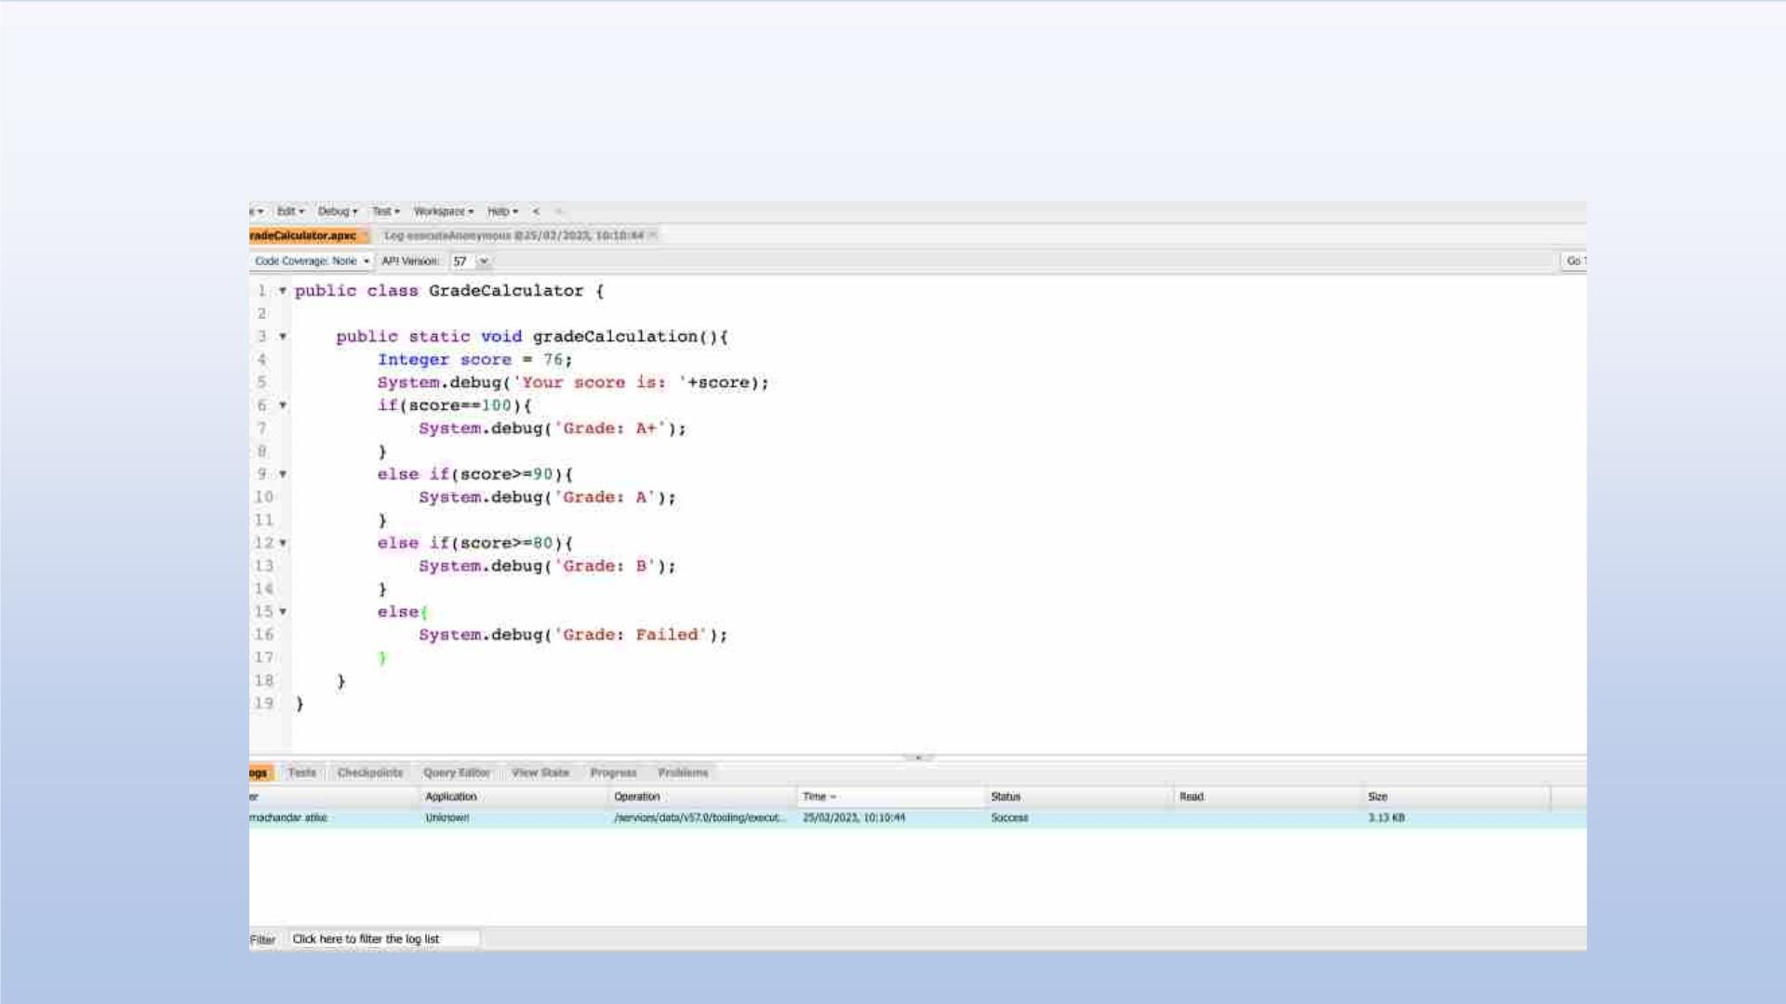
Exercise 6
Write a program and execute to demo the use of “If..else if...else”

Slide 40
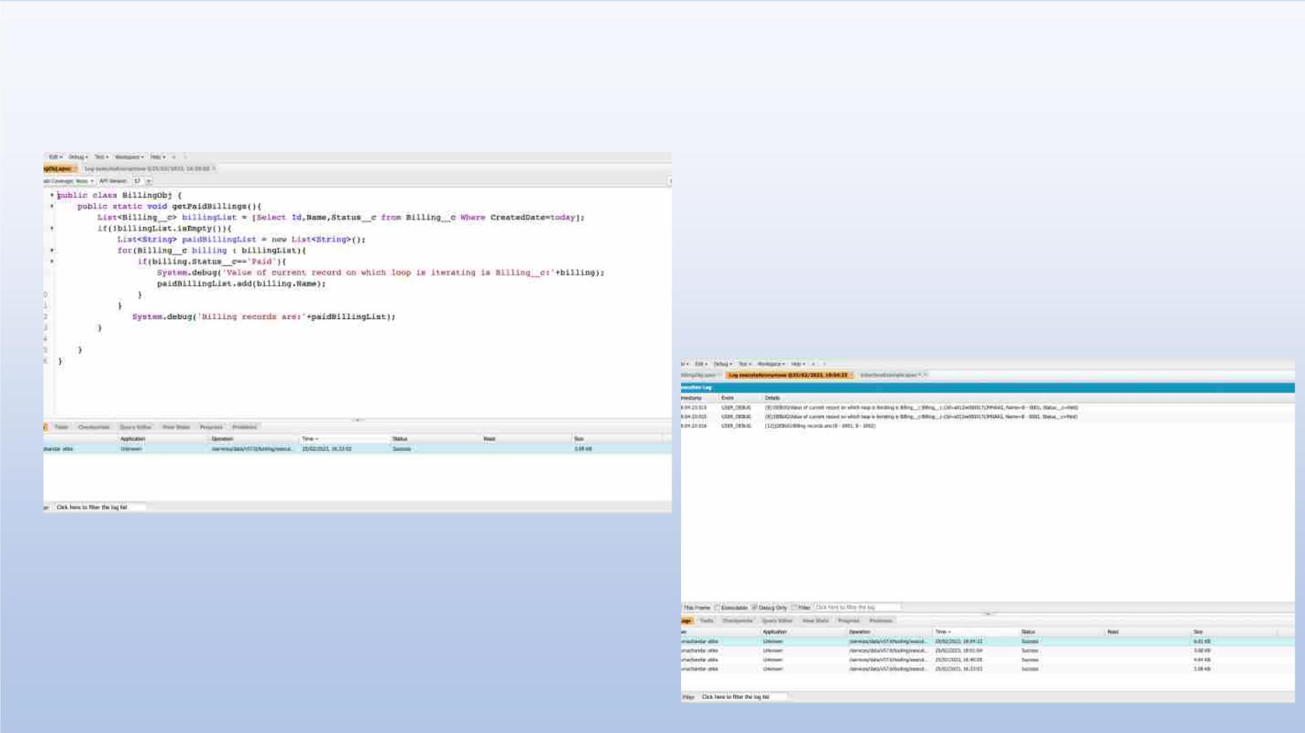
Exercise 7
Write a program to execute and demo the use of “Apex – for Loop”

Slide 41
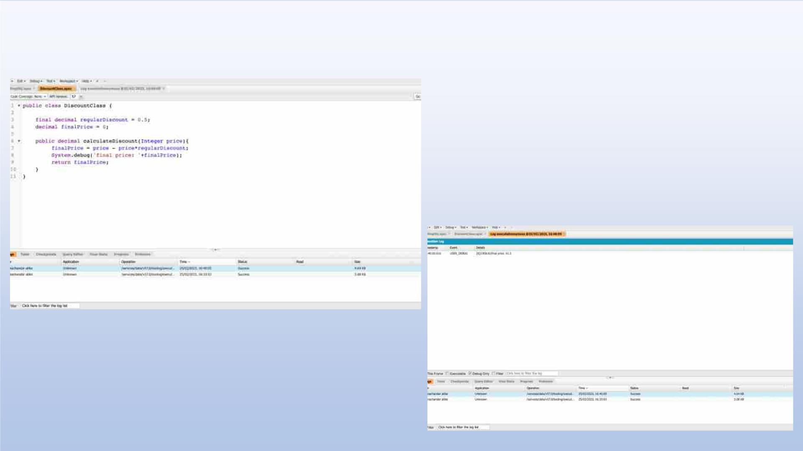
Exercise 8
Write a Class to demo the use of Constants in Apex

Slide 42
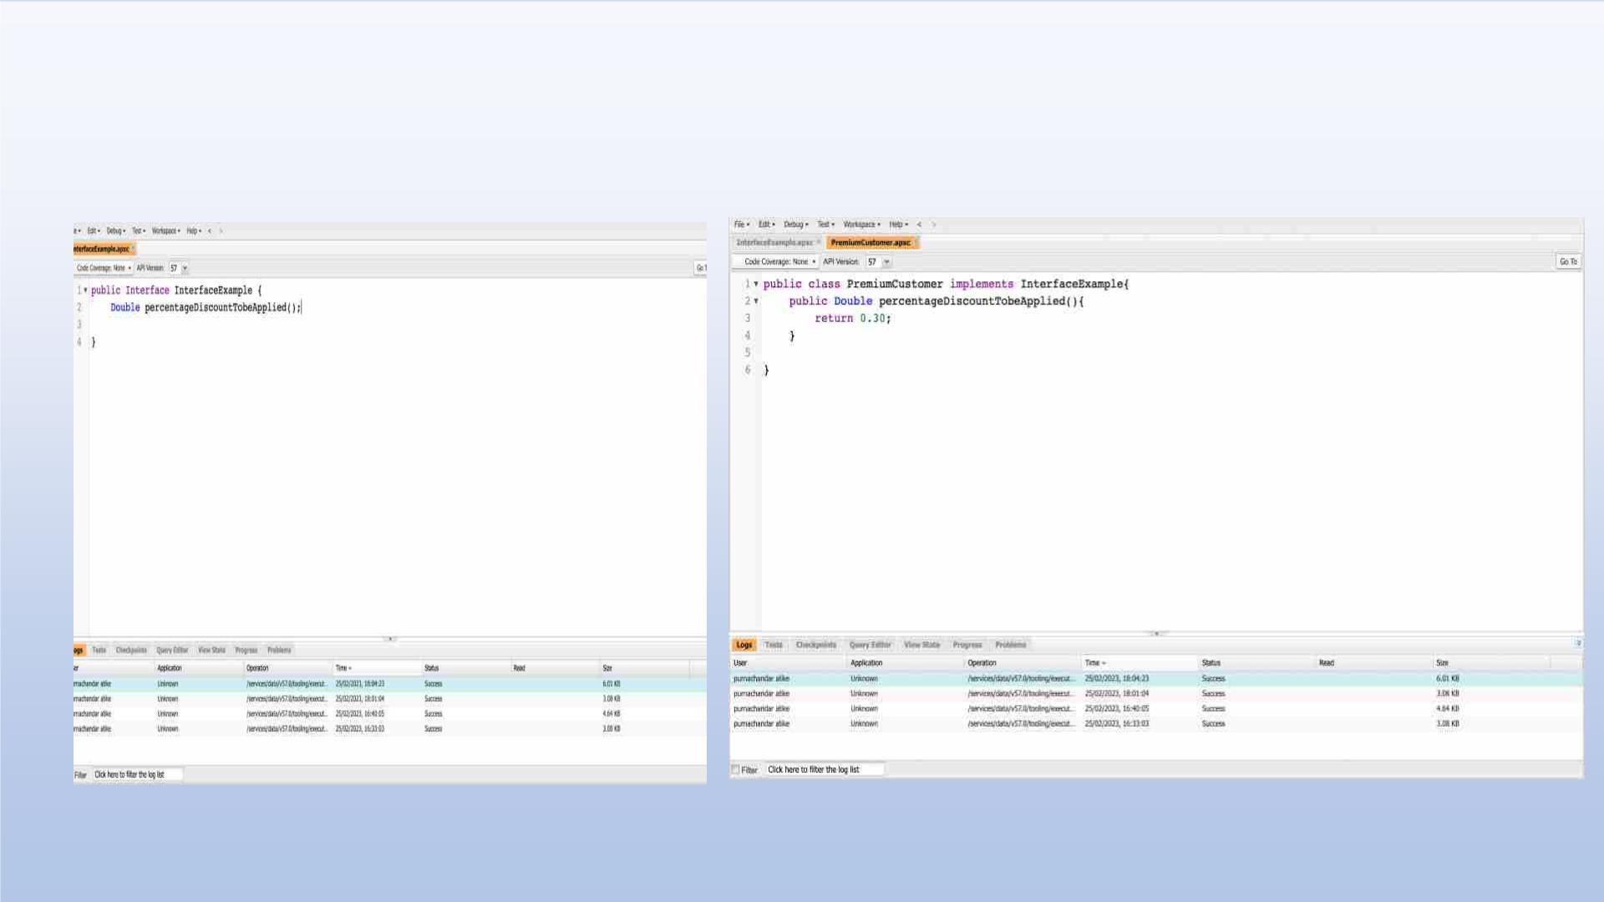
Exercise 9
Write a Class to demo the use of Interface in Apex

Slide 43
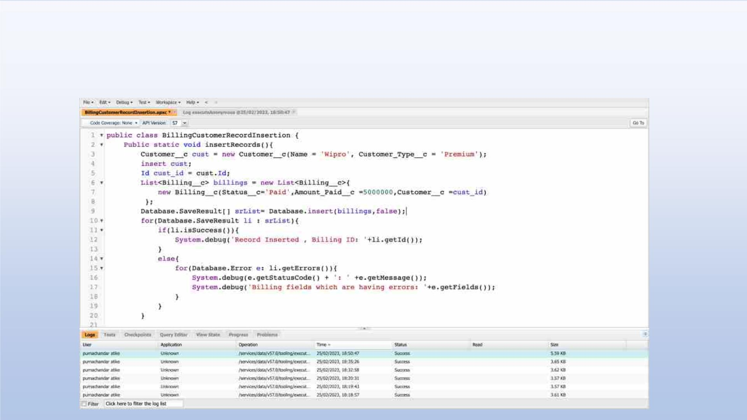
Exercise 10
Demo on DML Insert Operation Using Database methods
1.Insert a Customer Record First using simple DML Statement
2. Insert Billing record using Database methods Here use record id to insert customer

Slide 44
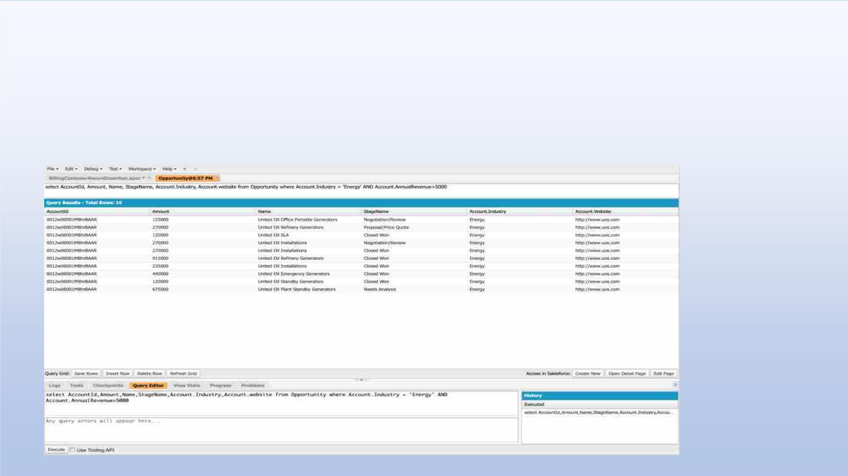
Exercise 11
Write and execute SOQL queries from Developer Console
Display ID, Amount, Stage, Account Name, Account Industry, Account Website
From Opportunity
AND “Account Annual Revenue > 5000”
Add a Where Clause “Account Industry = Energy”

Slide 45
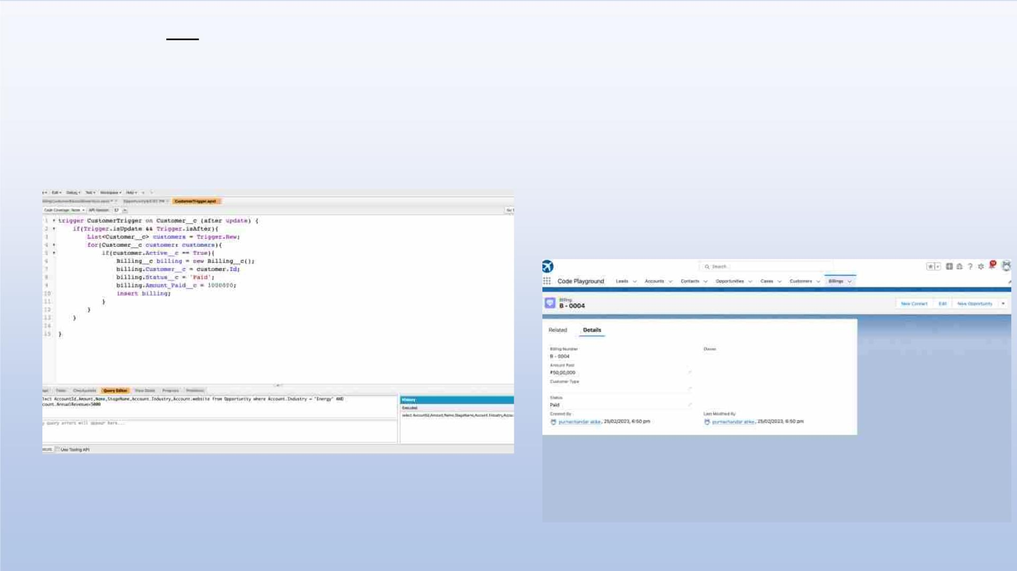
Exercise 12
Write an Apex Trigger, Name = CustomerTrigger.
Create a Billing Record when on Customer Object the 'Status' field changes to
Active from Inactive. Billing “Status” must be: Paid, Amount Paid = 1000000
Perform the DML on a List.

Slide 46
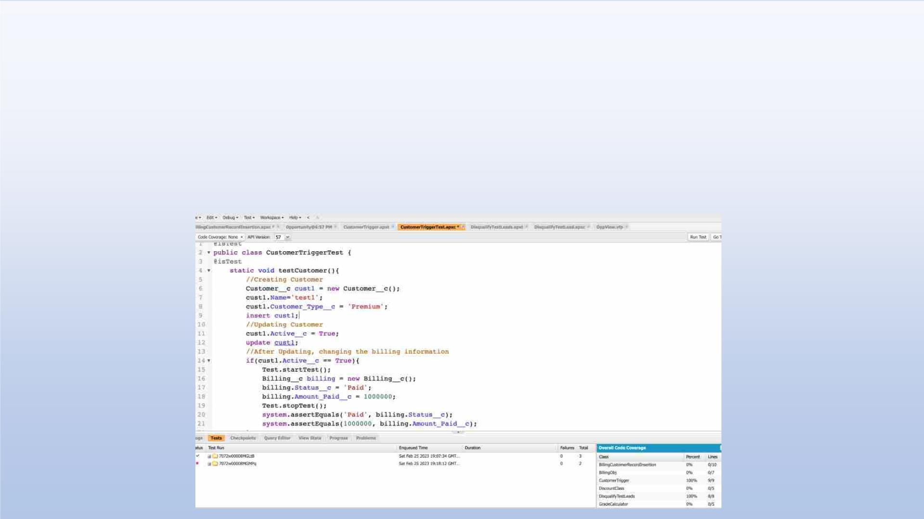
Exercise 13
Write a Test Class for CustomerTrigger.
Create the Data for the Customer custom Object
Use Test.startTest() & Test.stopTest().
Use assert statement to validate the output,
Test Class must have full code coverage.

Slide 47
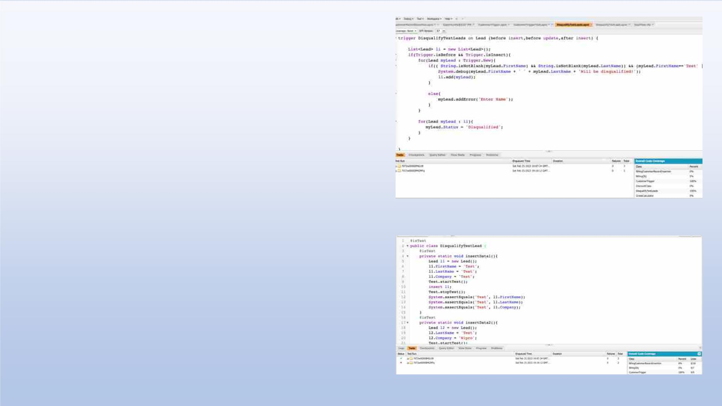
Exercise 14
ApexTrigger,Name=DisqualifyTestLeads
Exercise 15
Write a Test Class for DisqualifyTestLeads.

Slide 48
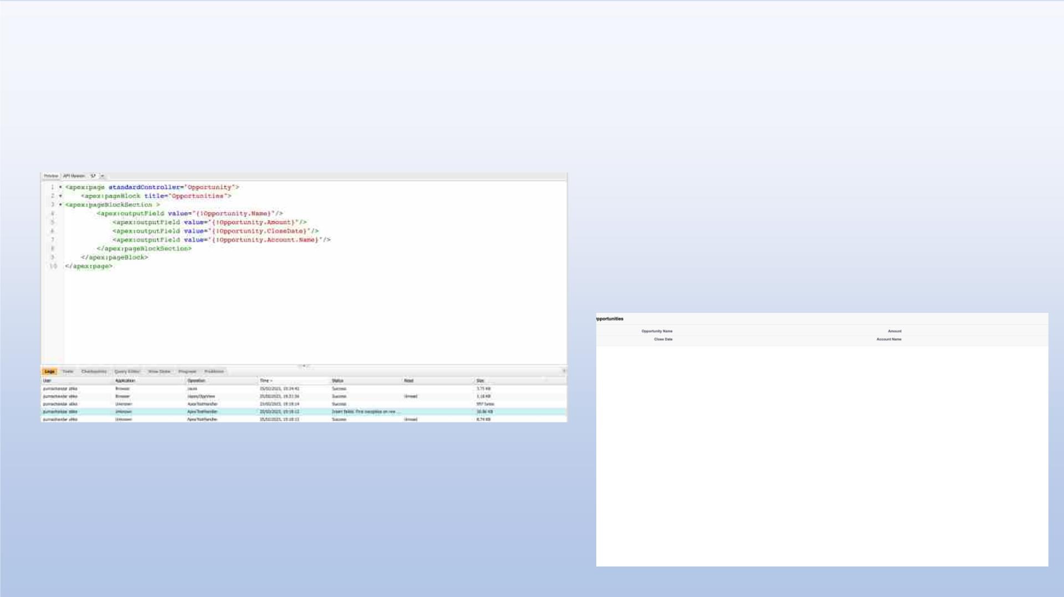
Exercise 16
Create a Visualforce page which displays Opportunity fields as output fields.

Slide 49
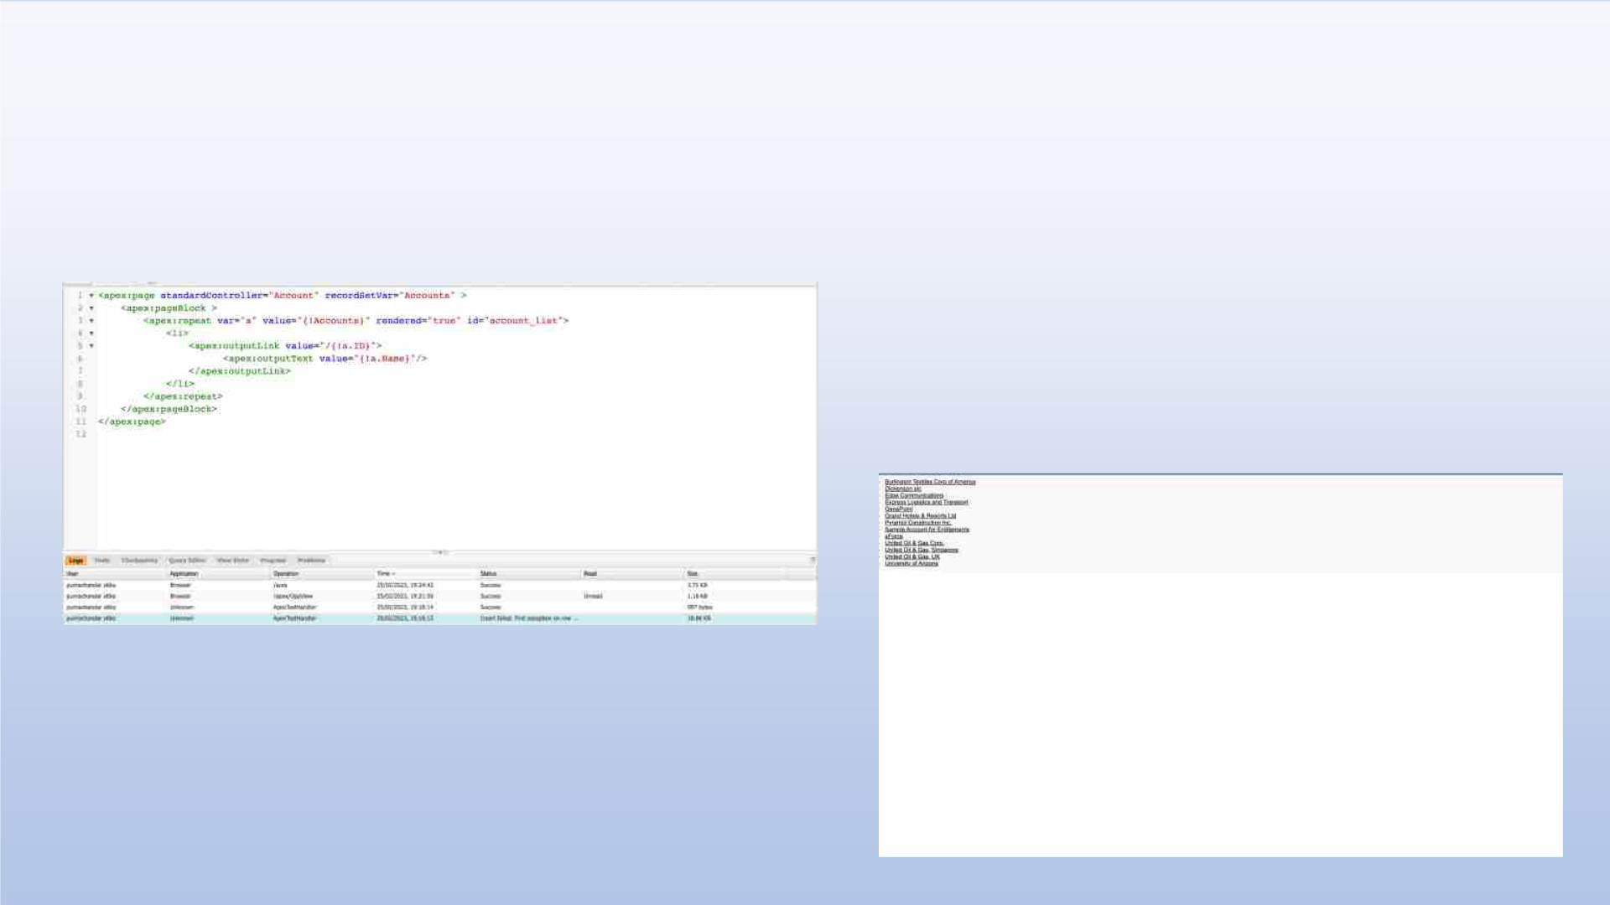
Exercise 17
Create a Visualforce page which shows a list of Accounts linked to their record
pages

Slide 50
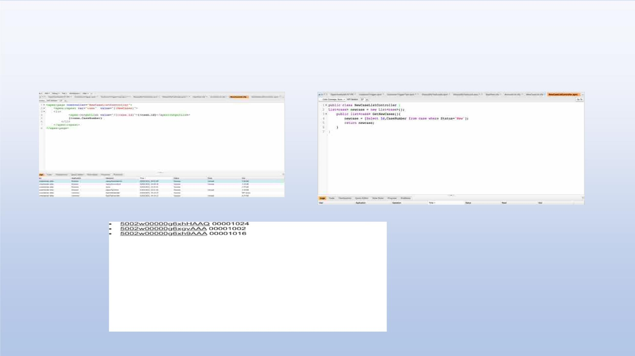
Exercise 18
Create a Visualforce page that uses a custom controller to display a list of
cases with the status of 'New'. The page must be named NewCaseList.

